Slide 1
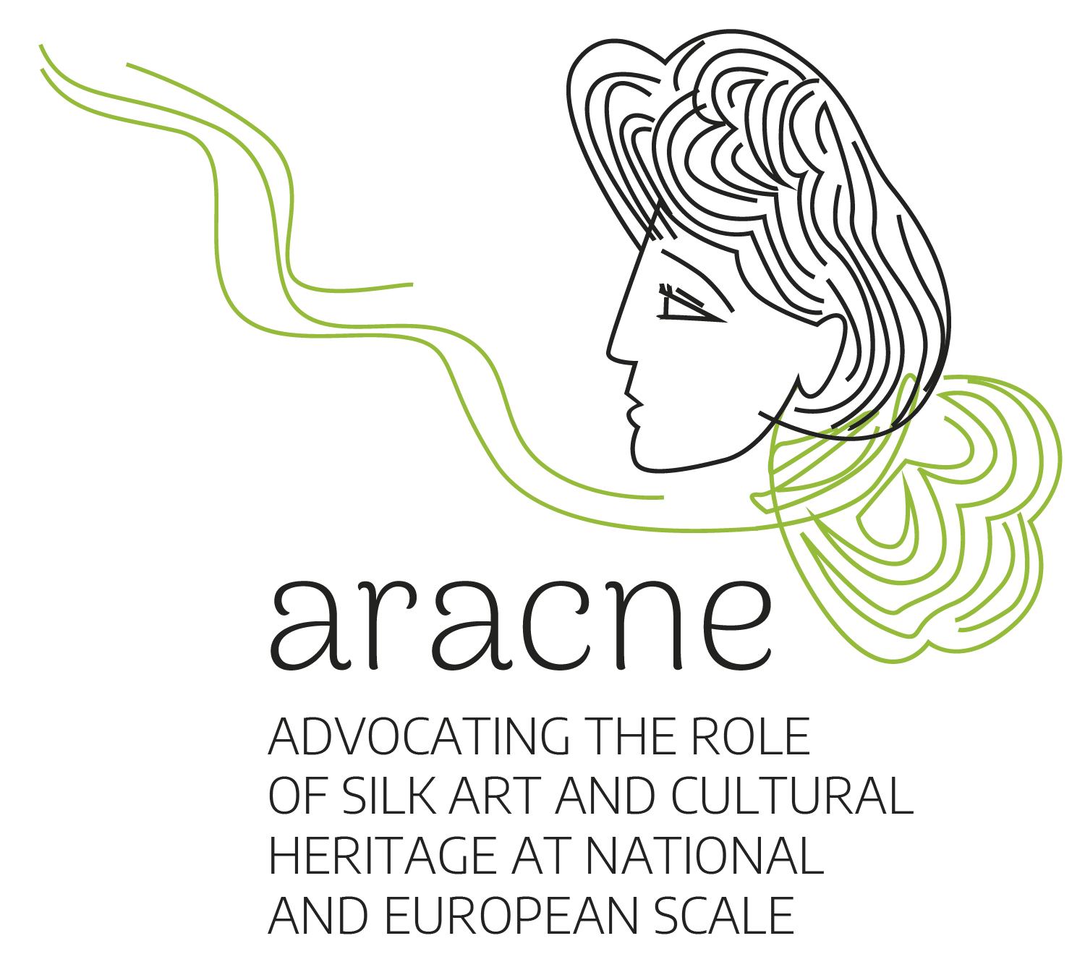
Defender el papel y el patrimonio cultural de la seda a escala nacional y europea
Development of virtual maps for points of interest of the European Cultural Silk Route
Funded by the European Union under the Grant Agreement 101095188. Views and opinions expressed are however those of the author(s) only and do not necessarily reflect those of the European Union or the European Research Executive Agency. Neither the European Union nor the granting authority can be held responsible for them.

Slide 2

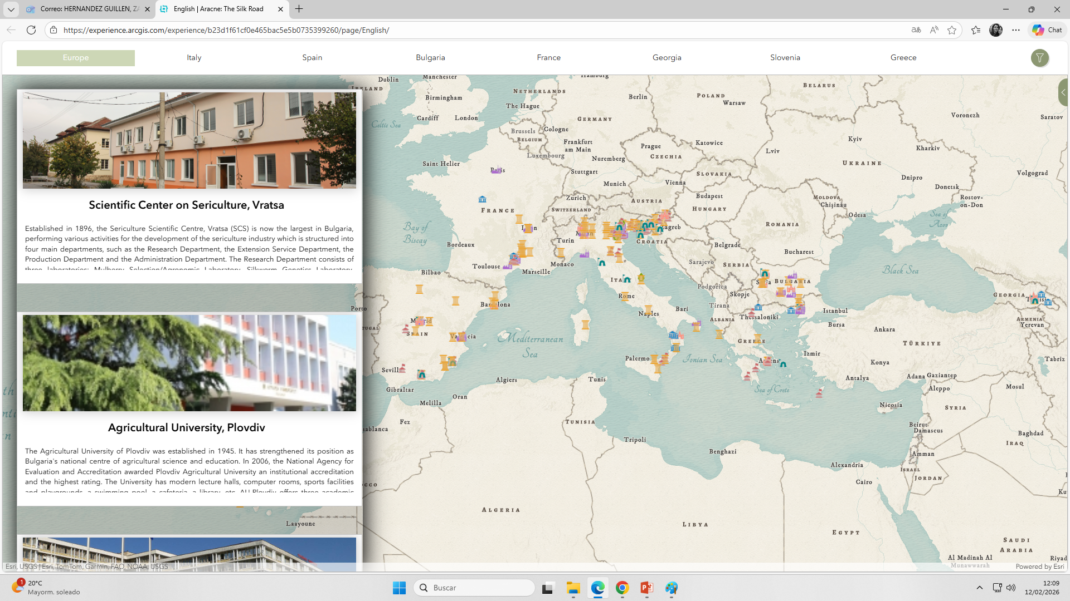
Development of virtual maps for points of interest of the European Cultural Silk Route
A virtual map has been created, accessible via the Internet, representing the tangible and intangible heritage of the Silk Road, with contributions from all project partners. https://experience.arcgis.com/experience/b23d1f61cf0e465bac5e5b0735399260/page/English/

Slide 3
Features of the map of points of interest:
Central map canvas with antique-style map
Left panel with photographs and explanatory texts
Two-part filter tool located in different places:
Filter by location
Filter by type
Language selector: 8 different languages
Pop-up with information

Slide 4
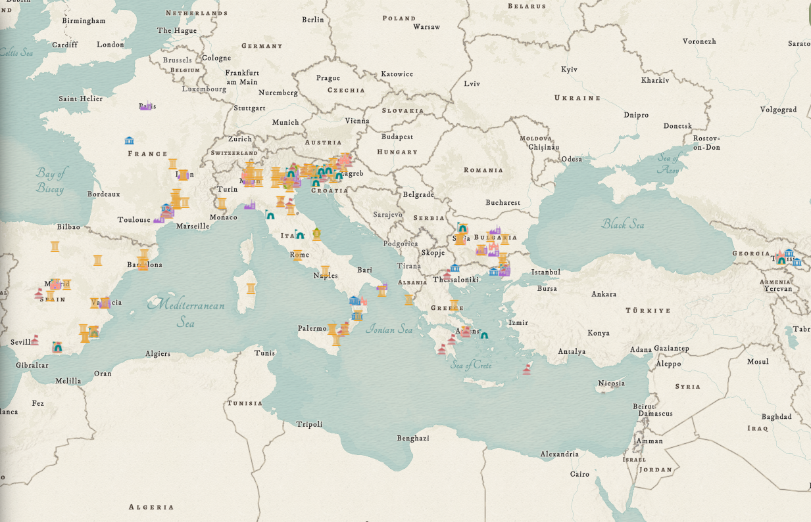
Features of the map of points of interest:
Central map canvas with antique-style map
Notes:
Here we can see how silk production which originated in Asia, subsequently spread to Europe and developed strongly in the Mediterranean and Balkan regions.

Slide 5
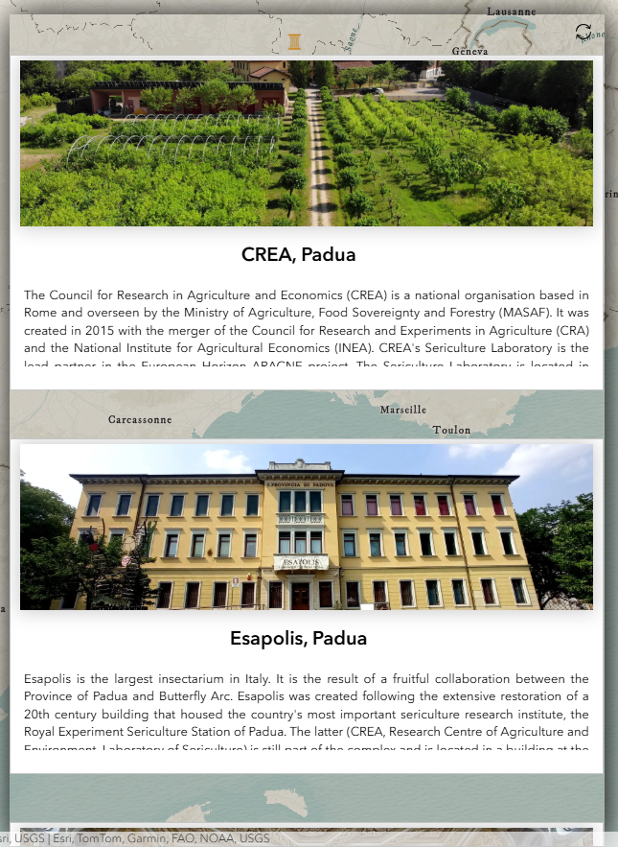
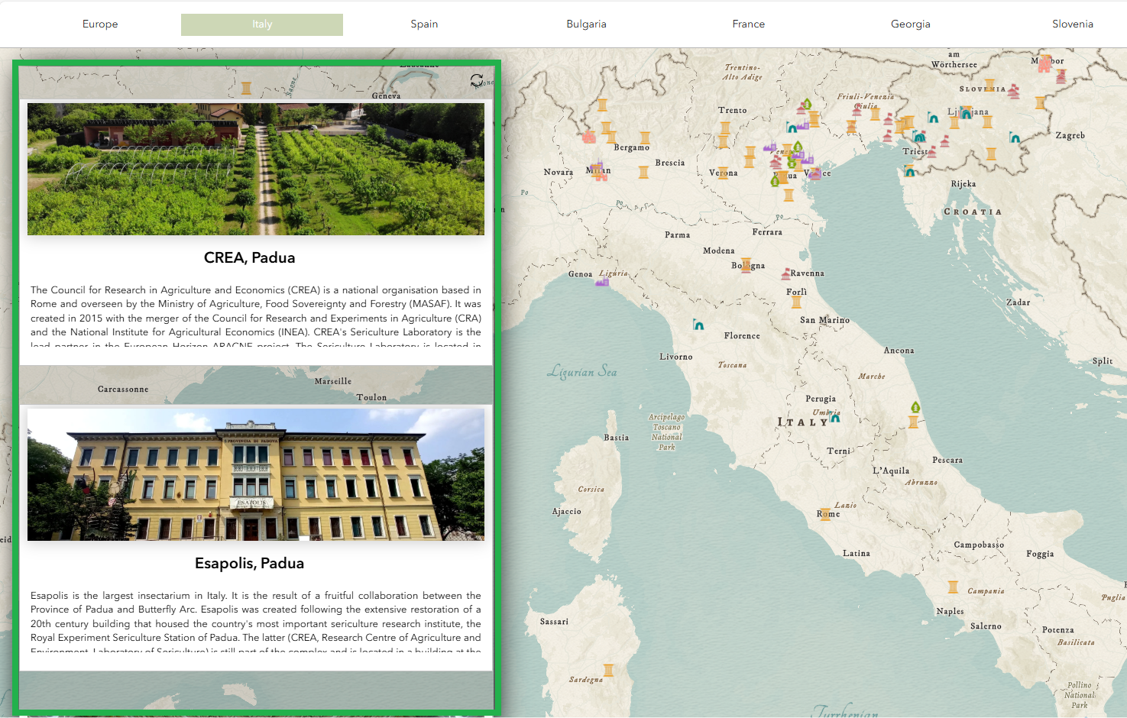
Features of the map of points of interest:
Left panel with photographs and explanatory texts

Slide 6
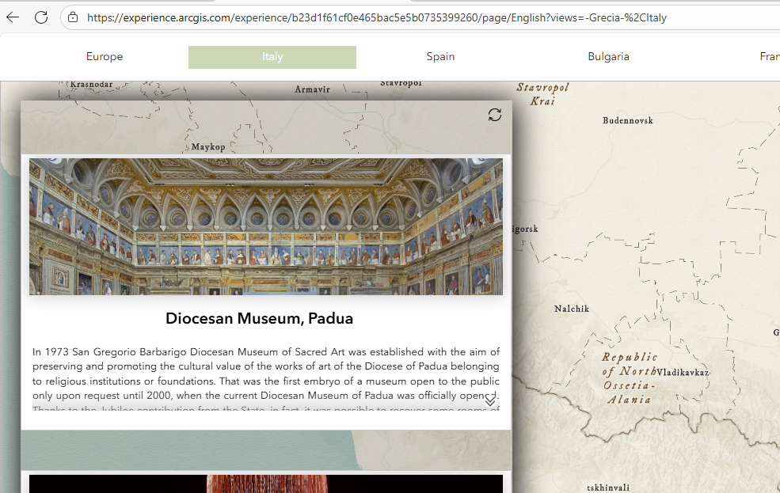
Notes:
En la esquina inferior derecha vemos dos pequeñas fechas que nos permiten bajar para poder leer el texto completo.

Slide 7
Features of the map of points of interest:
Two-part filter tool located in different places:
Filter by location
Filter by type
Notes:
La barra superior contiene filtros espaciales predefinidos a forma de bookmarks para cada país de los participantes en el proyecto. Haciendo clic sobre uno de los nombres de los países nos lleva a un zoom sobre su territorio.
El segundo de los filtros se despliega al hacer clic sobre el icono de la esquina superior derecha. Vemos entonces un nuevo panel en el que podemos seleccionar el tipo de punto por el que filtrar.

Slide 8
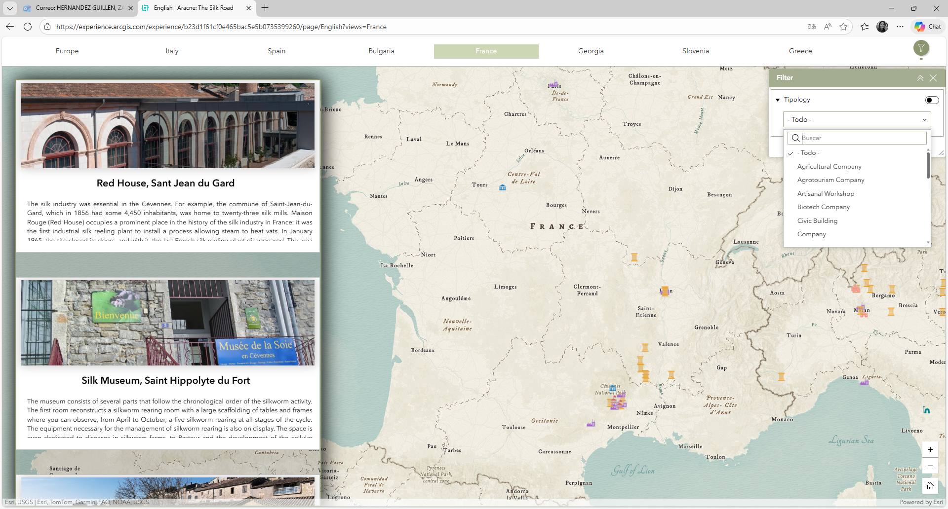

Slide 9
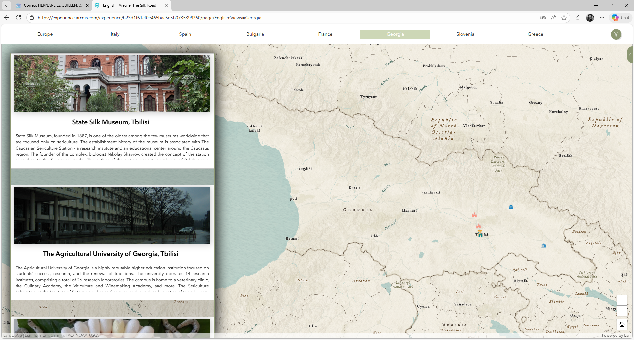

Features of the map of points of interest:
Language selector: 8 different languages
Notes:
El selector de idiomas se sitúa en el lateral derecho. Al hacer clic sobre ese icono aparecen las banderas para elegir el idioma que representan

Slide 10
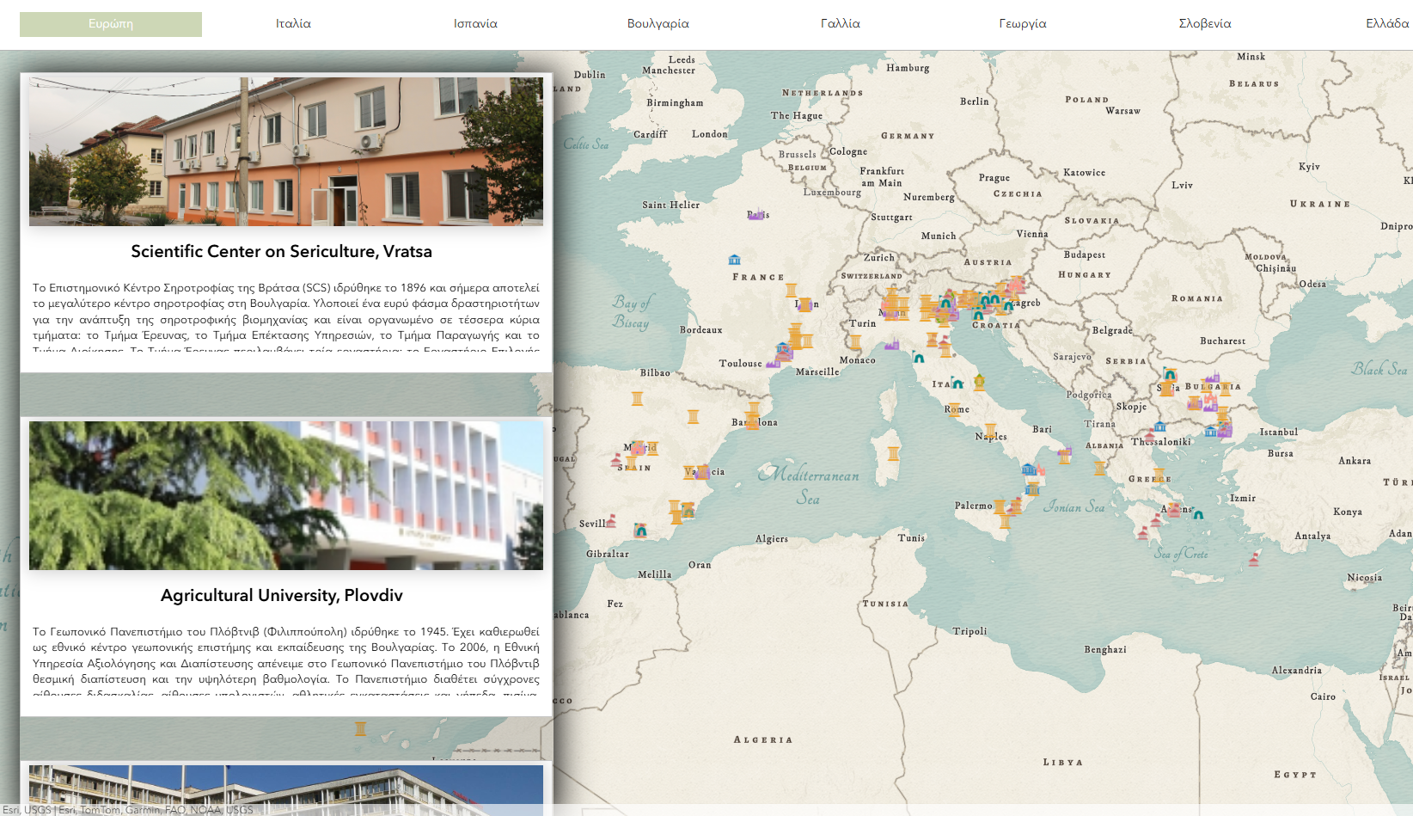
Notes:
Aquí podemos ver varios ejemplos con los idiomas griego, georgiano y búlgaro. He elegido estos para mostrar que la aplicación es capaz de aplicar diferentes tipos de alfabetos en la codificación de caracteres.

Slide 11
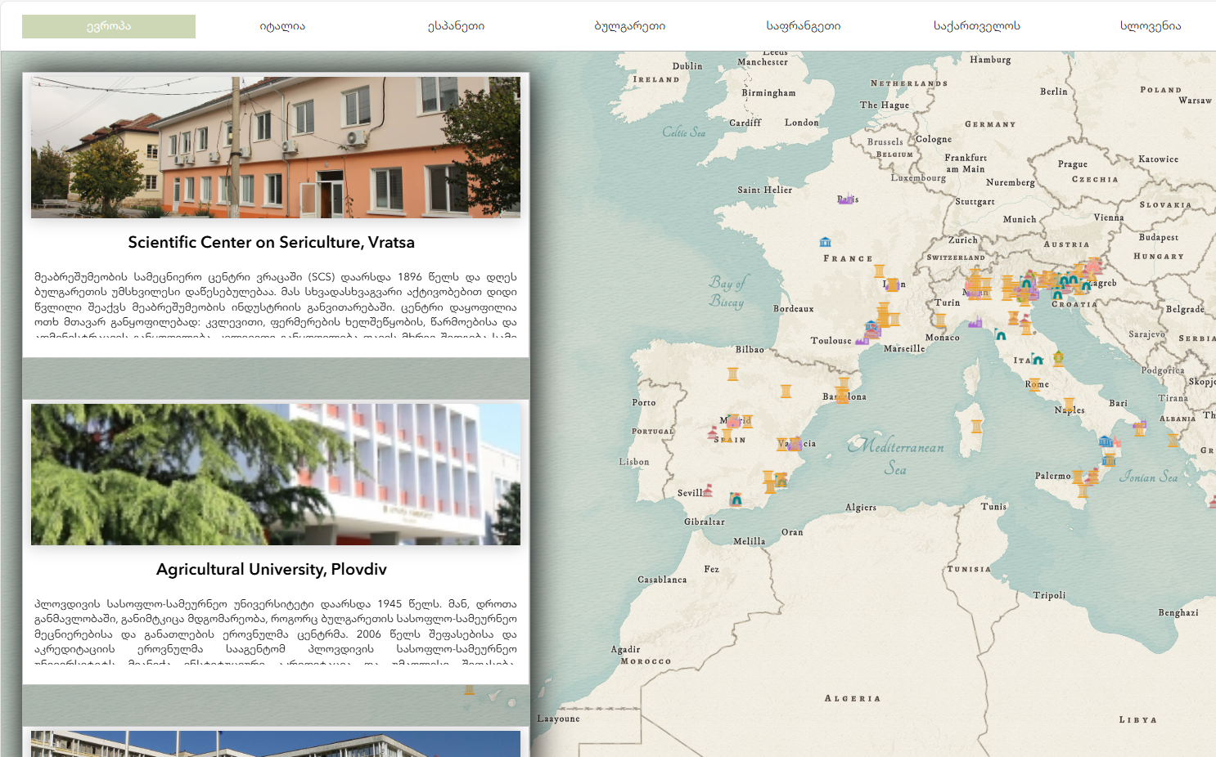

Slide 12
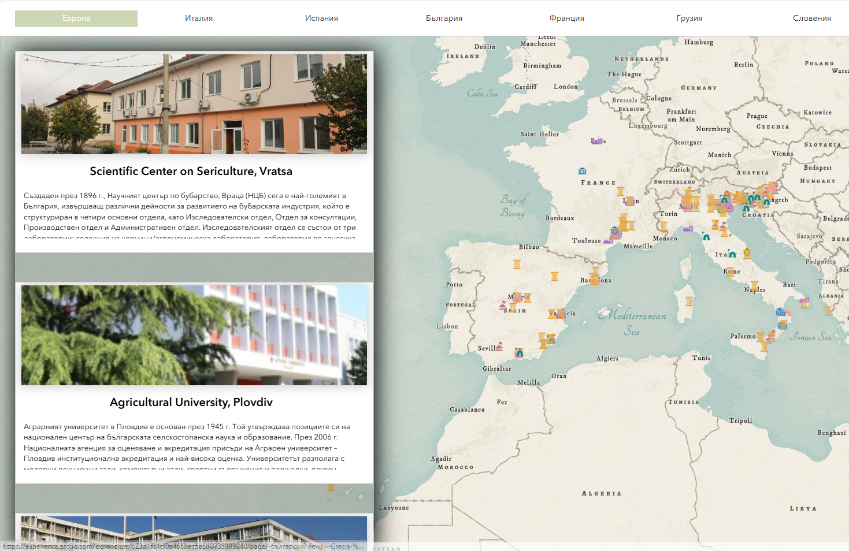

Slide 13
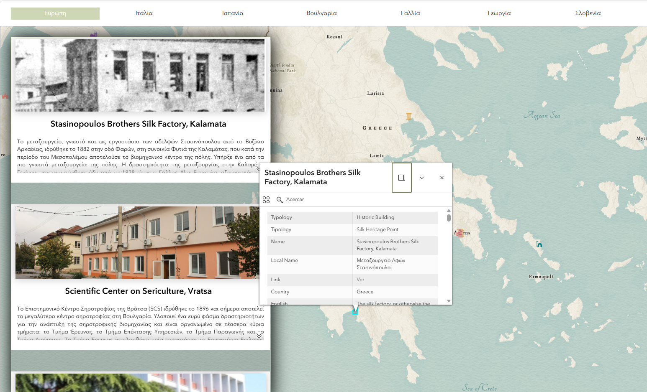
Features of the map of points of interest:
Pop-up with information
Notes:
Por último, podemos acceder a la ventana que muestra toda la información almacenada en la base de datos sobre un registro haciendo clic sobre ese registro en el mapa. Aparece el pop-up y utilizando la barra del scroll podemos ir bajando y viendo toda la información incluidos los link y las fotografías.

Slide 14
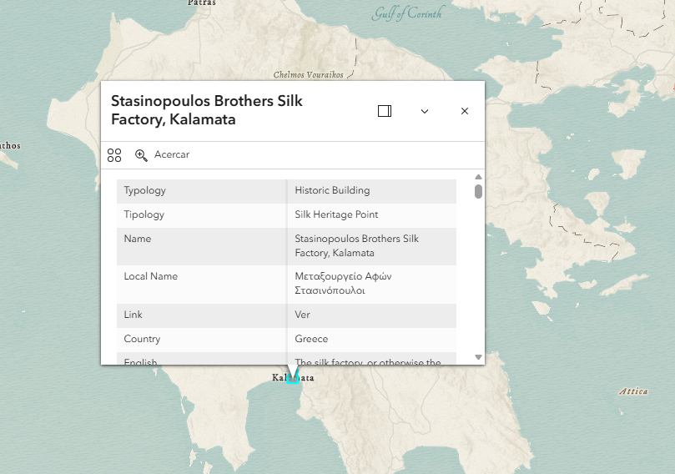

Slide 15
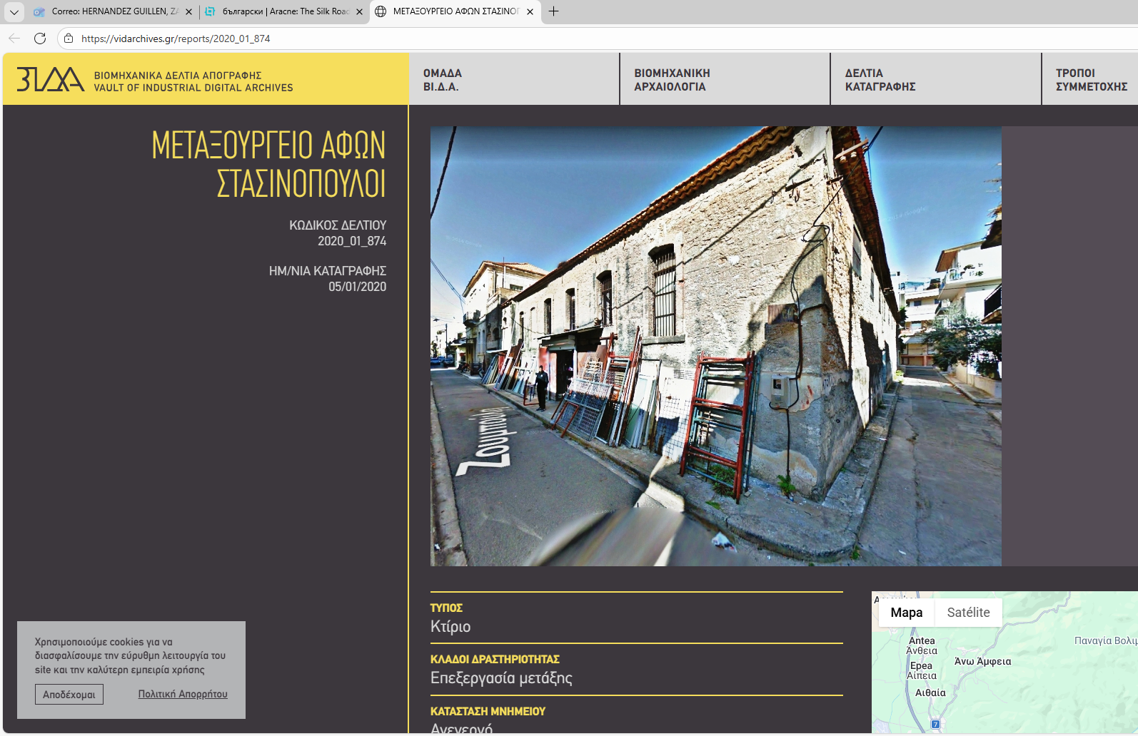

Slide 16
Steps :
01
02
03
04
Search for points of interest POI
Gathering information. Classification on tipology. Translate into different languages
Georeferencing the points
Generate thematic mapping
Production and publication of the cartography
Adding multi-media elements
At each point you can add links to images, webs and other.

Slide 17
Notes:
Algunos datos sobre el mapa. Se han recogido 234 puntos en total. Y aquí podemos ver el número de puntos por país.

Slide 18
Points by countries
Greece
11,1%
7,7%
Bulgaria
14,1%
Slovenia
11,5%
100%
Francia
18,4%
Spain
34,6%
Italy
2,6%
Georgia
Notes:
Y en la siguiente diapositiva vemos la contribución en porcentaje.

Slide 19
Notes:
Al completar la información de cada uno de los puntos se ha tenido que elegir a que categoría de las siete principales pertenece (Agricultural landscape, Company, Farmer, Historic Building, Institution, Museum y Other)

Slide 20
Notes:
Y en este por país y por tipología.

Slide 21
Notes:
Hay una segunda clasificación más detallada donde encontramos 22 tipos de puntos. Por ejemplo los museos se dividen en 5 tipos, Cutural museum, ethnological museum, Religius museum, sillk museum and textile museum. Y podemos observar como son los denominados cultural museum los más numerosos seguidos por los Silk museum. This map can be the basis for a future European Silk Route intended as a cultural itinerary across Europe.

Slide 22
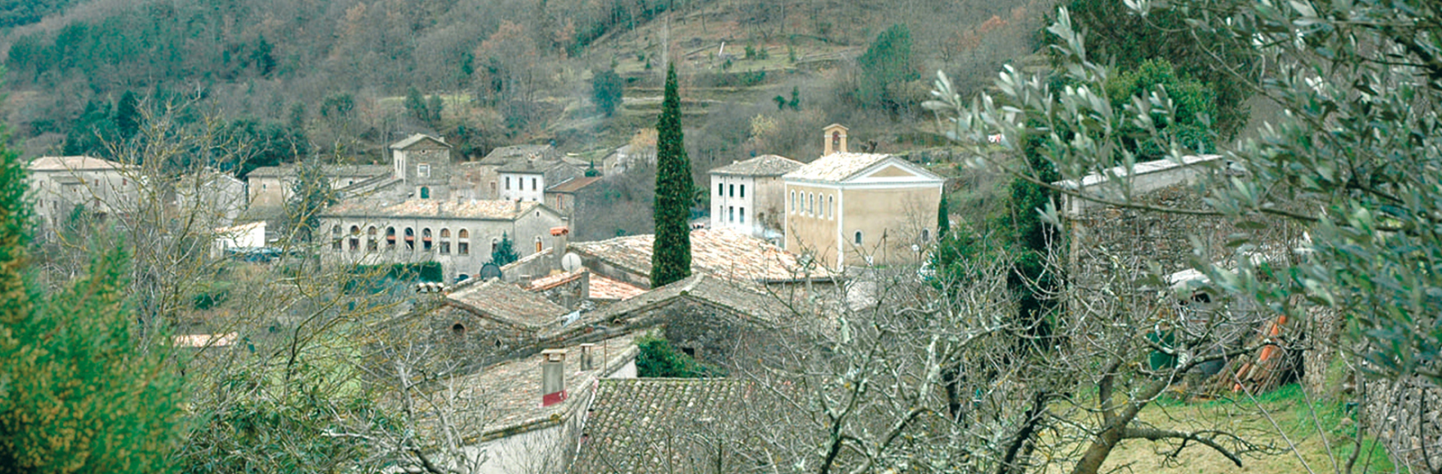
This map can be the basis for a future European Silk Route intended as a cultural itinerary across Europe. This map shows examples of how sericulture shaped European territories, landscapes, arts, culture, genetics, production, industrial and built heritage and values through mulberry cultivation and silkworm rearing, silk processing and trading, as unifying element but with local diversities.
Cros Valley, Cros. France.
A journey through the landscape of a valley marked by sericulture, silkworm rearing... Every step you take reveals traces of this activity, which has now disappeared.

Slide 23
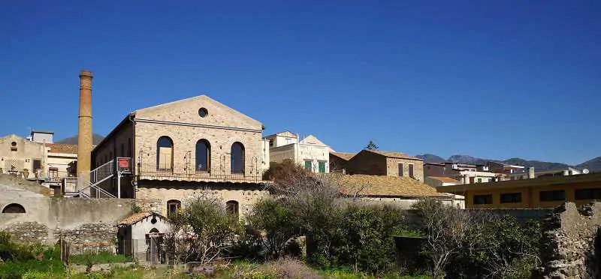
Cogliandro Reeling Plant, Villa San Giovanni
Villa San Giovanni has a long tradition in the silk industry, particularly in reeling and weaving. This activity, present in the area from the end of the 18th century until 1951, gave rise to a prosperous industrial district known as "Little Manchester".

Slide 24
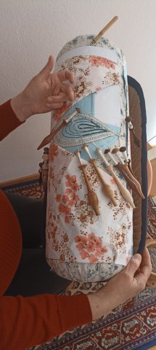
Lace school Idrija, Idrija
The Idrija Lace School is a comprehensively designed handicraft centre where nearly 500 children and young people, as well as over 150 adult lace makers, learn the art of bobbin lace every year. Bobbin lace-making is a living tradition, and Idrija lace is made entirely by hand. Since 2018, Bobbin lace-making in Slovenia has been inscribed on the UNESCO Representative List of the Intangible Cultural Heritage of Humanity.

Slide 25
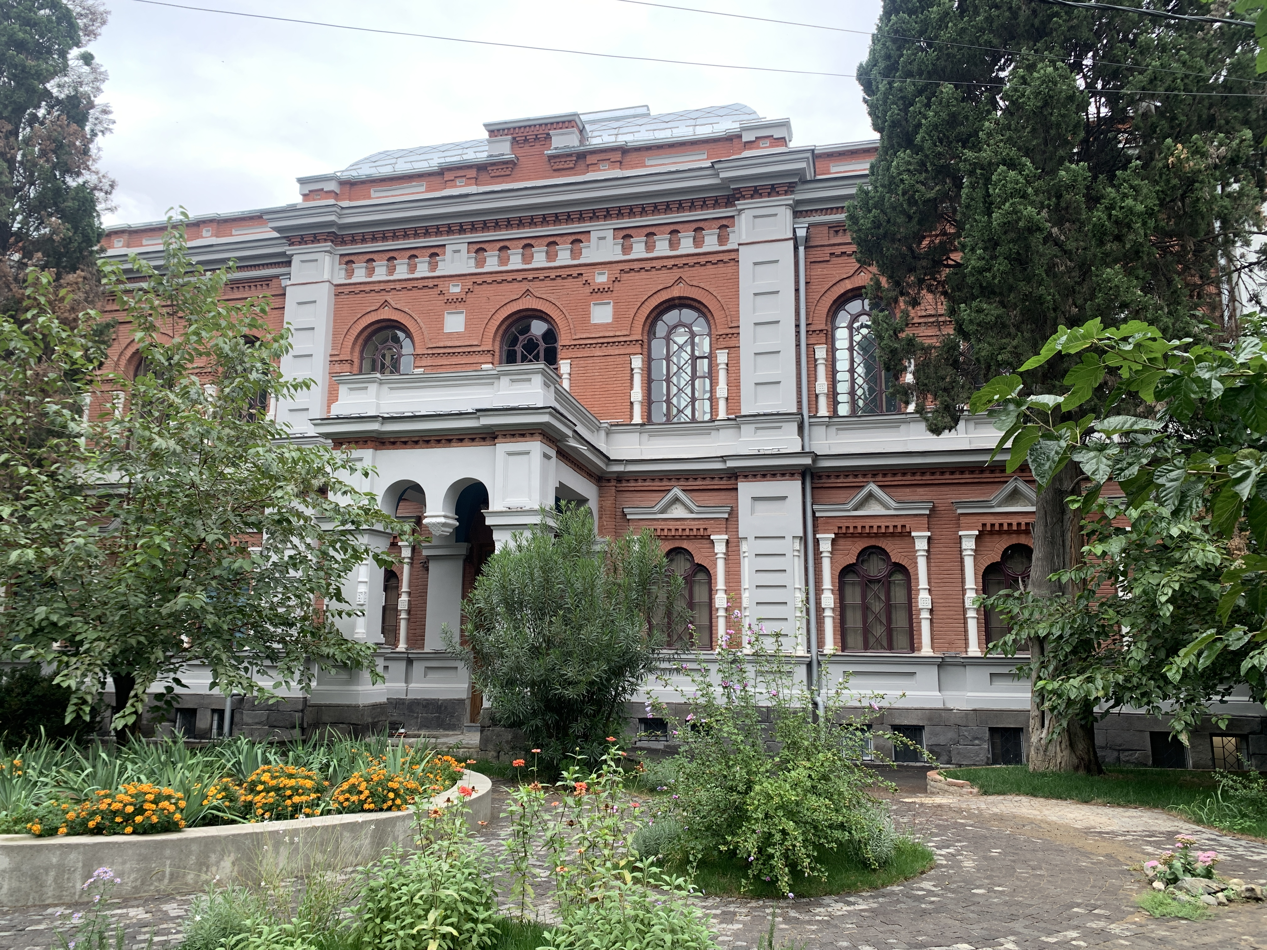
State Silk Museum, Tbilisi
State Silk Museum, founded in 1887, is one of the oldest among the few museums worldwide that are focused only on sericulture.

Slide 26
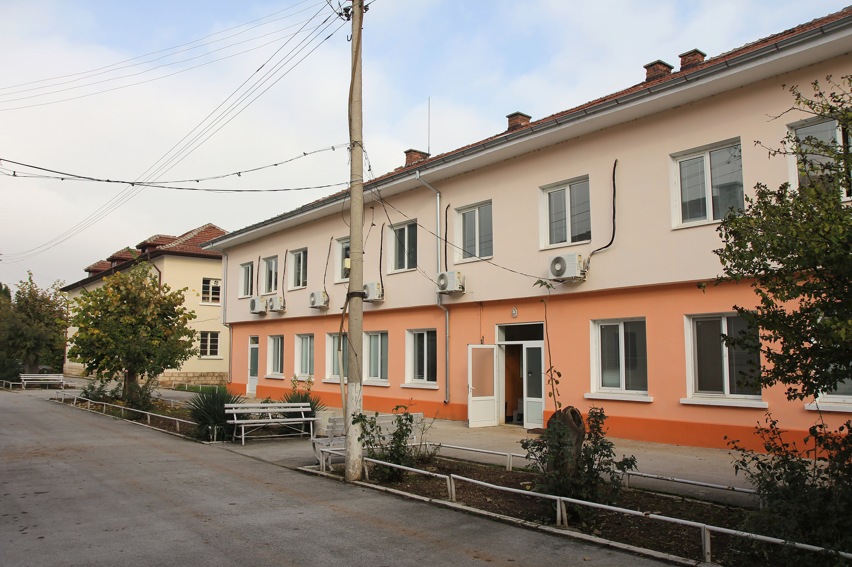
Scientific Center on Sericulture, Vratsa
Established in 1896, the Sericulture Scientific Centre

Slide 27
Funded by the European Union under the Grant Agreement 101095188. Views and opinions expressed are however those of the author(s) only and do not necessarily reflect those of the European Union or the European Research Executive Agency. Neither the European Union nor the granting authority can be held responsible for them.
https://aracne-murcia.hub.arcgis.com/

