Slide 1

Slide 1/8
ARACNE Final Meeting
16th-17th February 2026, Padova
Of the silkworm and Europe: The beginnings
Presenter: Skarlatos G. Dedos (NKUA)

Slide 2
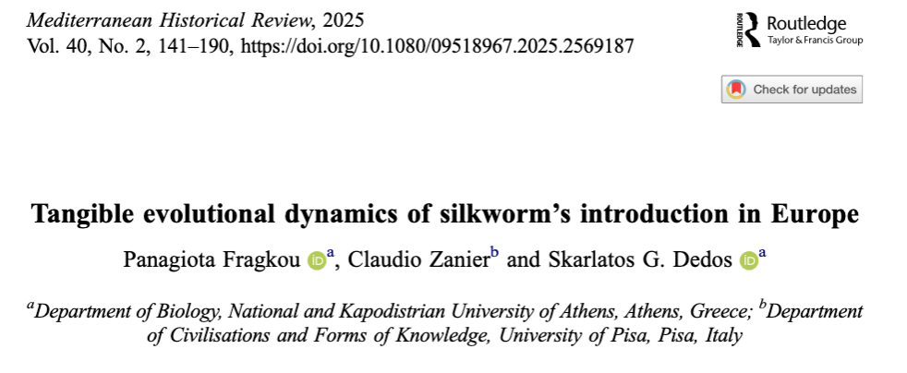
Of the silkworm and Europe: The beginnings
Slide 2/8

Slide 3
Of the silkworm and Europe: The beginnings
What was found….
Slide 3/8
✓First mention of silkworm rearing in Europe in Cordoba, Spain by 960, narrated in the Calendar of Cordoba
✓ First mention of silkworm rearing in Italy: In 1037, San Modesto monastery near Avellino
✓ First mention of silkworm rearing in Greece: In 1217/18, in Nafpaktos
✓ First mention of silkworm rearing in France: In1494, in Dauphiné in the Rhône region

Slide 4
Of the silkworm and Europe: The beginnings
What was found….
Slide 4/8
✓First reported attempt to introduce the silkworm in Europe: In 547 by the Byzantine Empire, a failed attempt!
✓ First description of the silkworm’s life cycle: By Michael of Ephesus (1050-1120)
✓ First poetic description of the silkworm; By the Byzantine poet Manuel Philae , circa 1300
✓ First illustration of the silkworm: In Bologna, in 1427
✓First description of silkworm races: In the poem Bombyx, circa 1485 by L. Lazzarelli

Slide 5
Of the silkworm and Europe: The beginnings
What was found….*
Slide 5/8
✓No evidence that the silkworm was reared in the Byzantine Empire
✓ Silkworm was introduced in Greece through the Venetian colonies in the 15th century
✓No evidence that the silkworm was reared in the Ottoman Empire or the Balkans before the 16th century
✓ The silkworm was reared in Georgia probably much earlier and after 1071 through its proximity to Gilan, Persia
* Must always look at the direct evidence!

Slide 6

Of the silkworm and Europe: The beginnings
Slide 6/8
Detail of a 1427 image of the Statutes of the Silk Workers' Guild in Bologna, Italy.
The image is a detail that appears in the lower left and lower right corner of am much larger image. It depicts 3 Bombyx mori silkmoths and their eggs, a bolus of wrapped white silk and six white Bombyx mori cocoons. It dates back to 1427 and decorates the front page of the Statutes of the Silk Workers' Guild that existed at that time (founded in 1217) in Bologna, Italy, so the first illustration may actually be from 1217. These statutes, as a document, survive in the Municipal Library of Bologna, Italy.

Slide 7
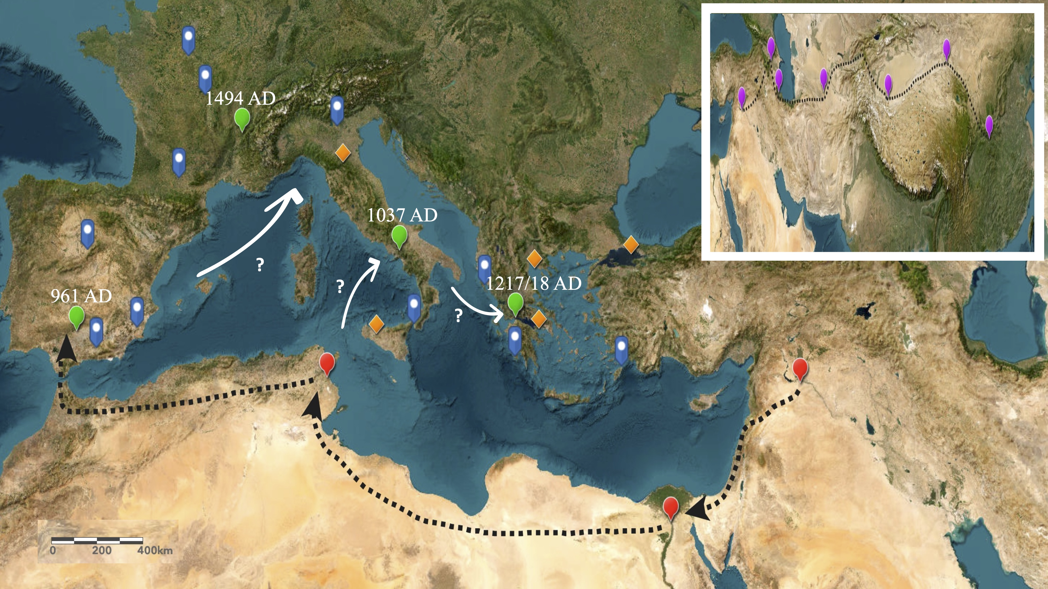
Of the silkworm and Europe: The beginnings
Slide 7/8
Depiction of documented geographical sites in Europe, Africa and the Middle East where silkworm rearing and silk productions were taking place until the first decades of the 16th century.

Slide 8
Of the silkworm and Europe: The beginnings
Slide 8/8
Thank you for your attention!

