Slide 1



Catalogue of silkworm strains
CREA
Sericulture Station of Padova
Luca Tassoni
February 16th 2026
THIS PROJECT IS FUNDED BY THE EUROPEAN UNION’S HORIZON EUROPE RESEARCH AND INNOVATION PROGRAMME UNDER THE GRANT AGREEMENT NO 101095188

Slide 2
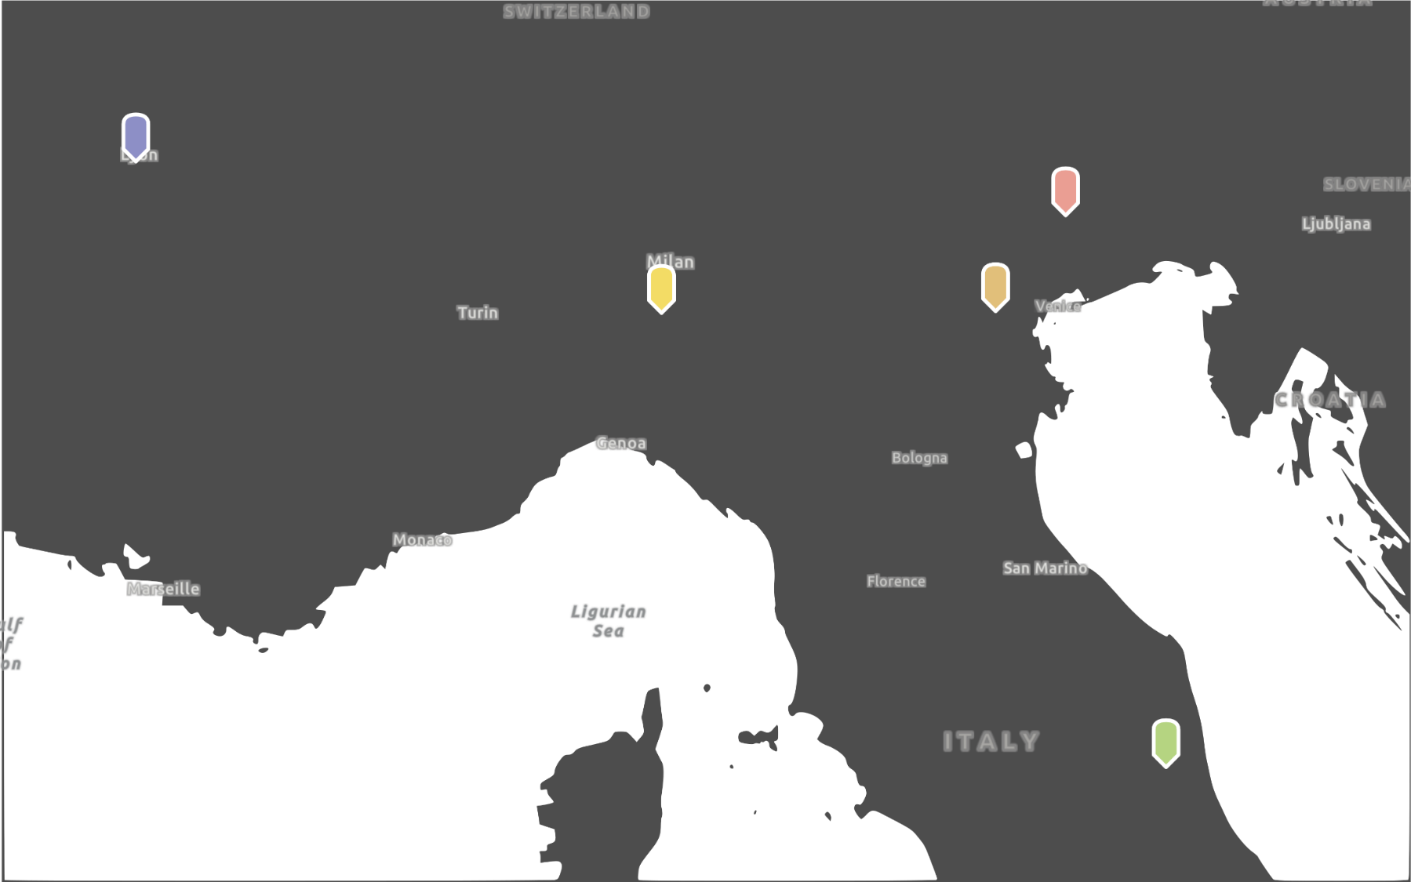
History of the strain collection
1918 – The collection was established by Dr Porzia Lorenza
Lombardi, director first of the Sericulture Station
of Ascoli Piceno and later of the Sericulture
Laboratory of Padova
1979
2009
1958 – Transfer of the collection to Padova
1958
1963 – acquisition of the Strains from the Spallanzani
Institute of Pavia
1963
1979 – acquisition of the strains from the Egg Production
Centre of San Giacomo di Veglia (Treviso)
1918
2009 – acquisition of the French national collection,
from the Unité Sericicole de La Mulatière (Lyon)
Notes:
As you know, the Sericulture Station of Padua maintains a large number of silkworm strains from all over the world.

Slide 3
What is the catalogue of silkworm strains?
Strain features
Tool
Information about strain origin
Historical document
Rearing information
Grow together with the collection

Slide 4
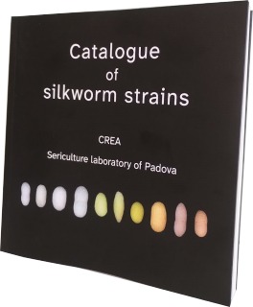

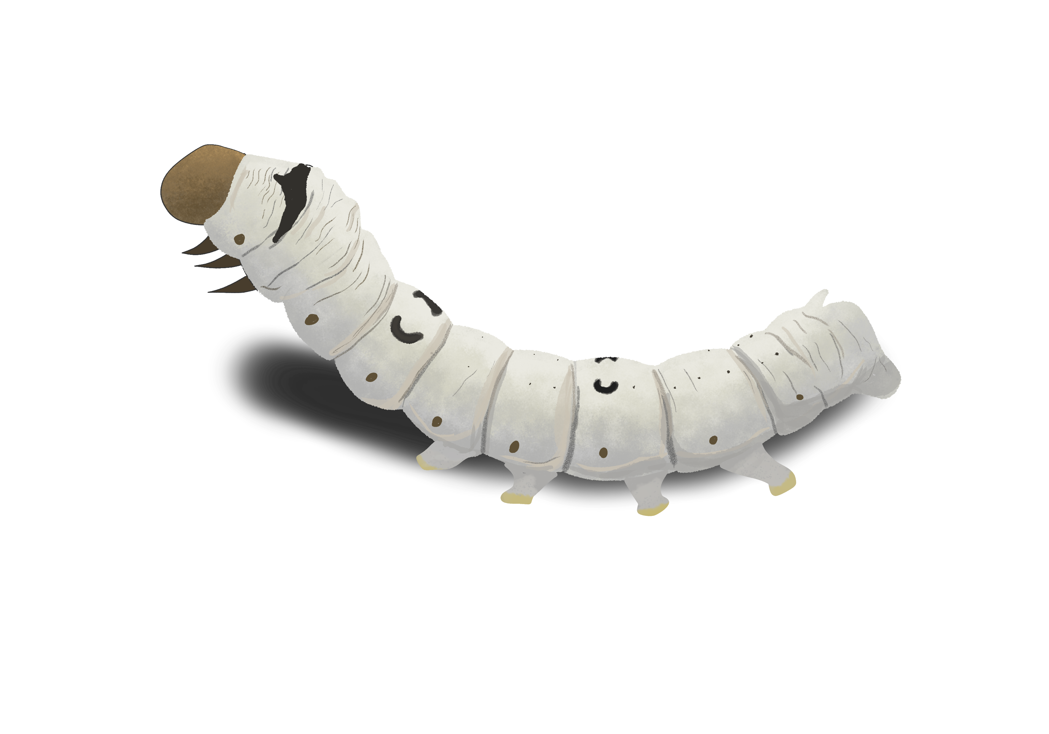
The catalogue
Starting from the internal silkworm strains catalogue of the Sericulture Laboratory of Padova
Content reviewed and updated
Terminology standardized
Translated into English for the first time
fully restructured with a refreshed graphic design

Slide 5
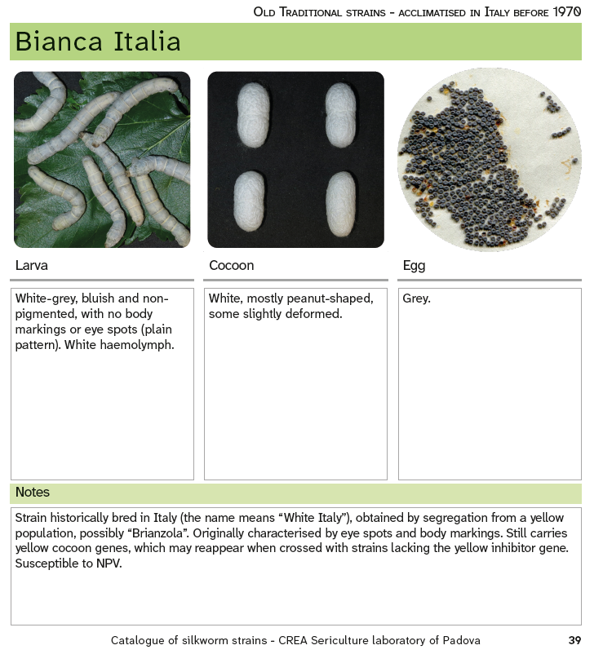
Catalogue entries
Description of 3 phenotypical traits: larva, cocoon, egg
The catalogue photographs have been completely renewed, with new images taken during the 2023 and 2024 seasons
Notes includes information about rearing, observations and historical information regarding the origin of the strain

Slide 6
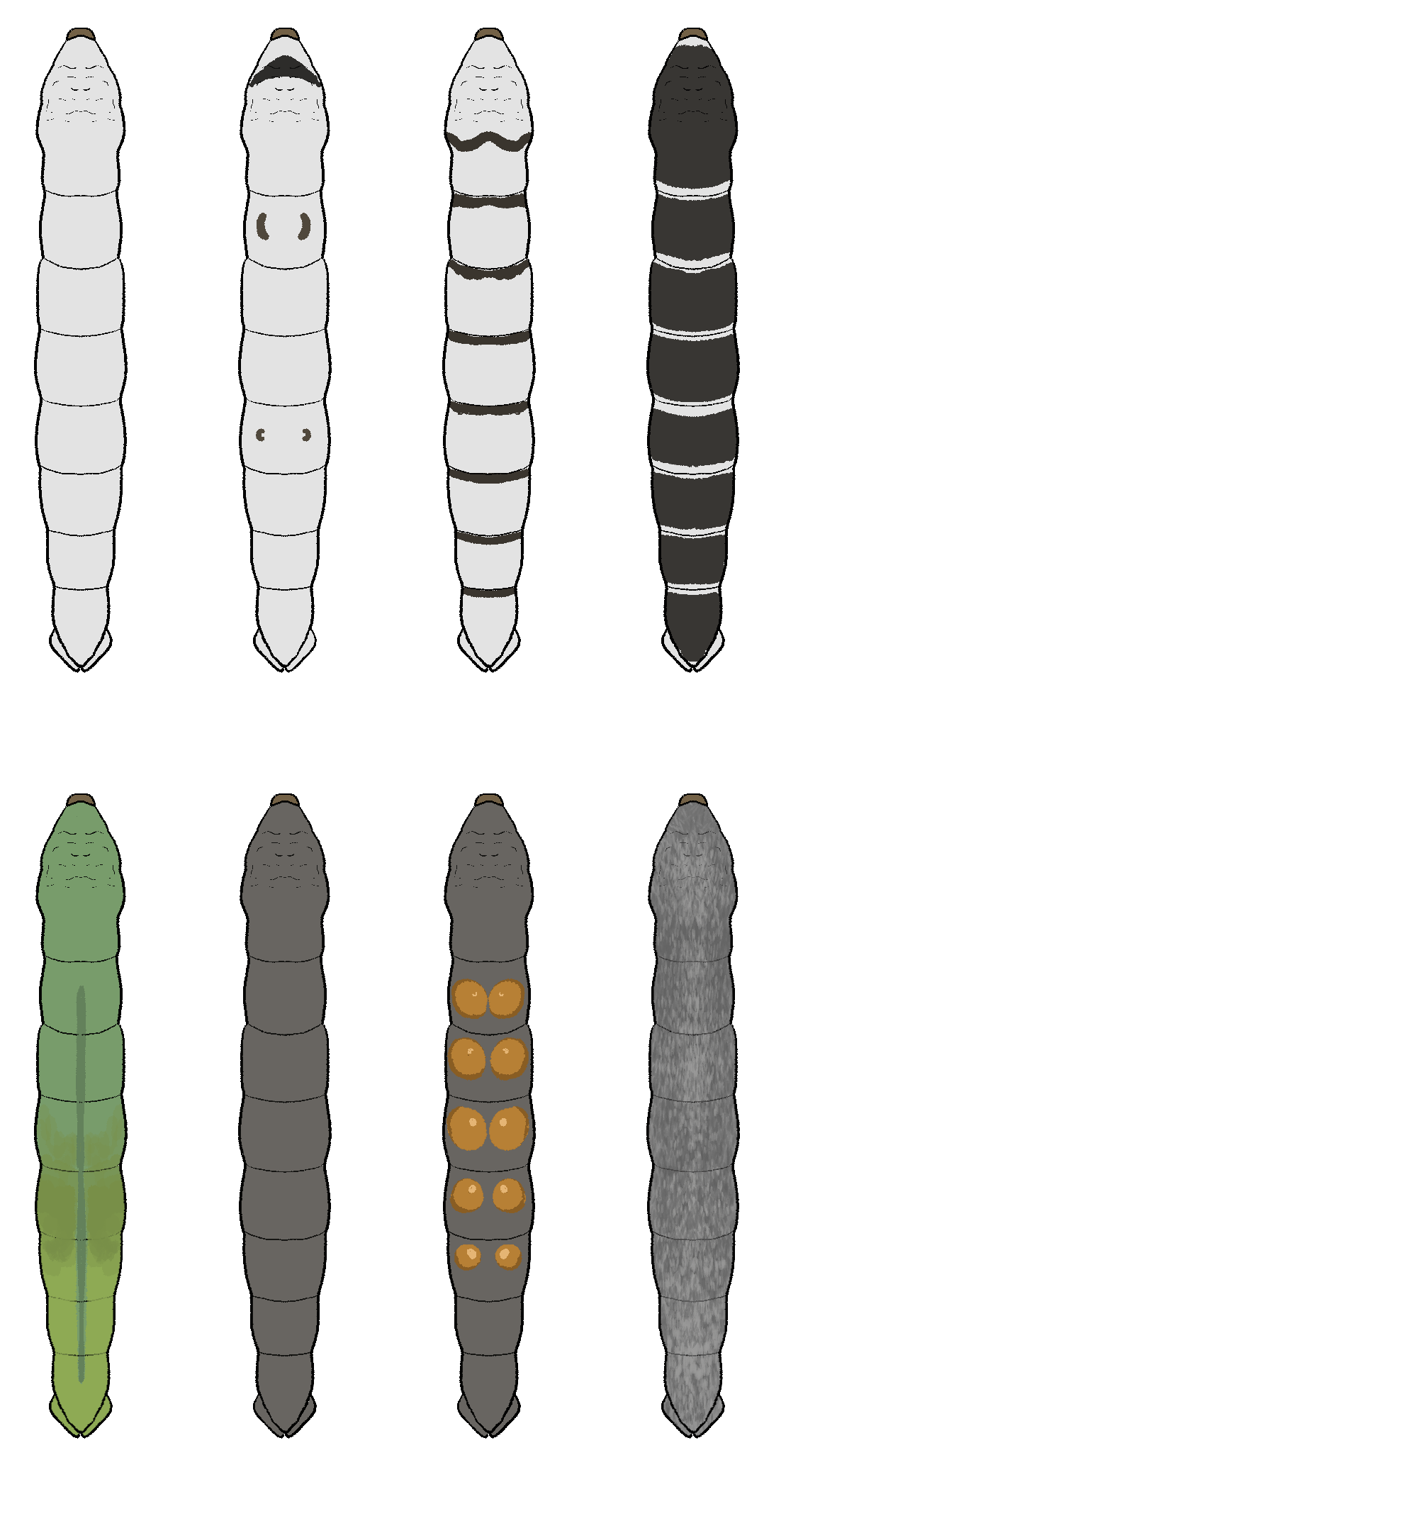
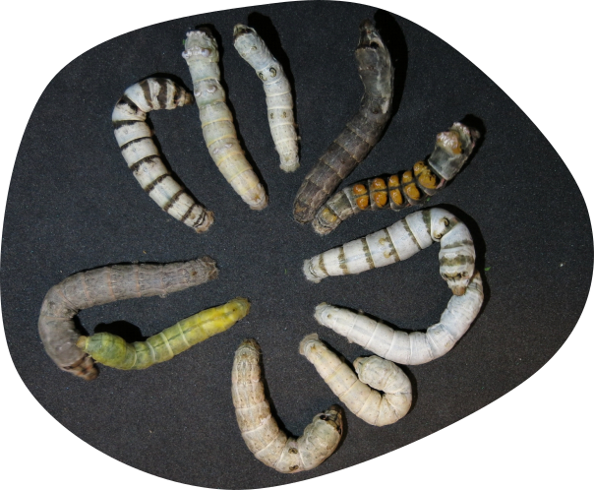
Phenotipic diversity

Slide 7
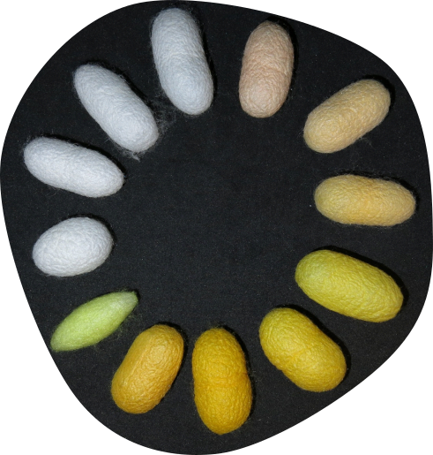
Phenotipic diversity

Slide 8
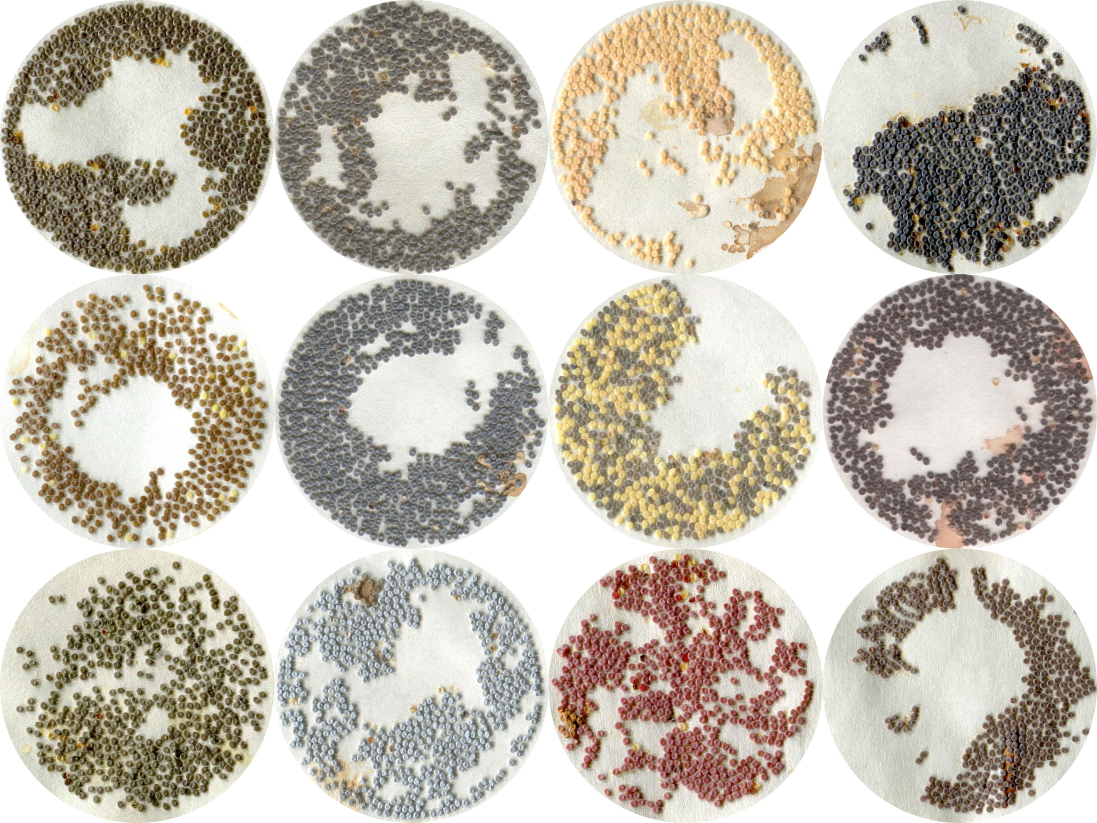
Phenotipic diversity

Slide 9
The catalogue is organised into 7 sections These reflects the different ways the strains were acquired
Notes:
We saw how single entries were organized but the catalogue is also organized in different sections or chapters. The organization of the strains in chapters follow the modes the strains were acquired

Slide 10
Sections of the catalogue
Old Traditional strains - acclimatised in Italy before 1970

Slide 11
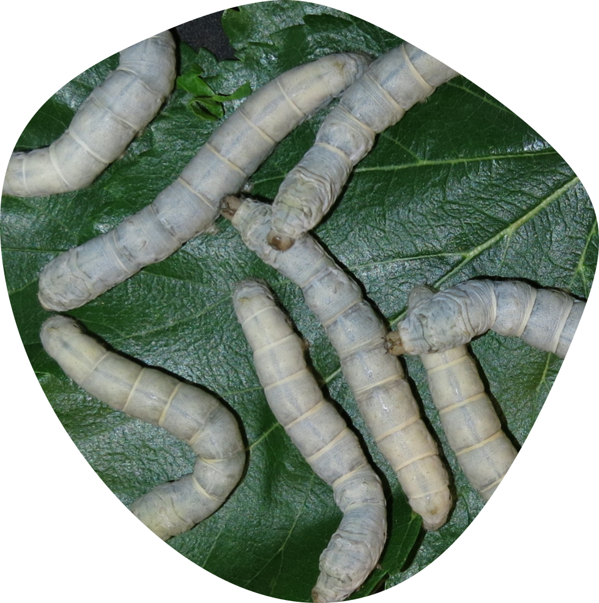
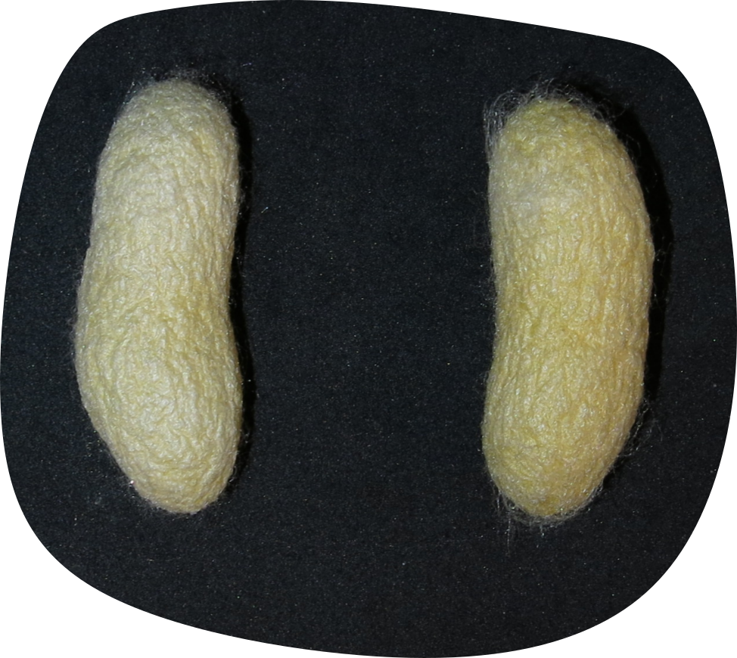
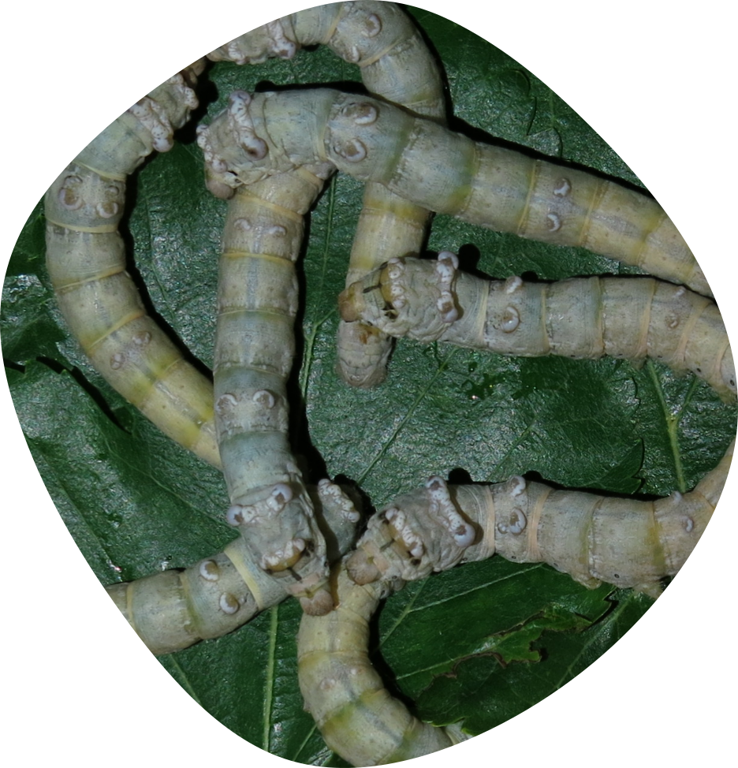
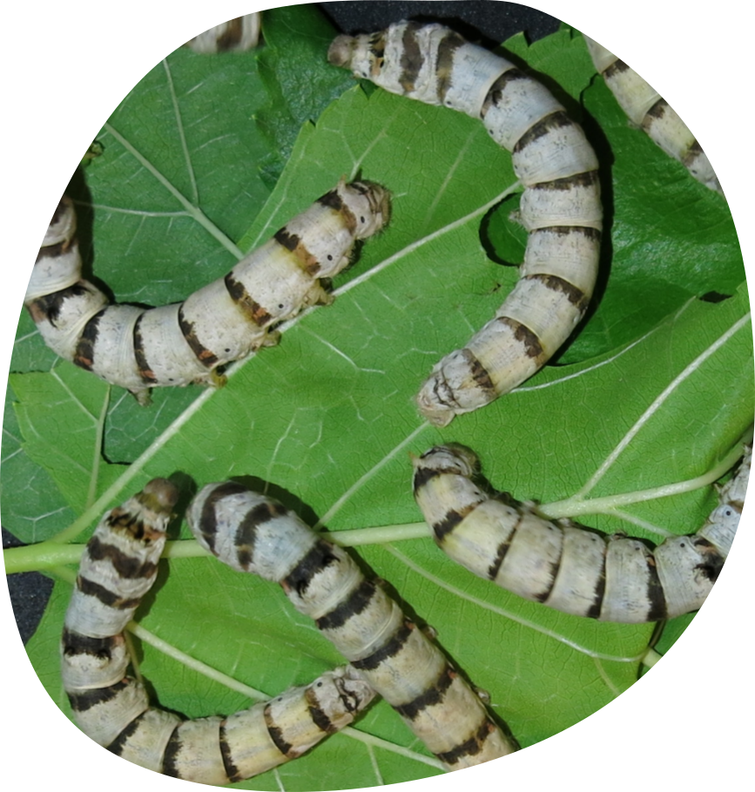
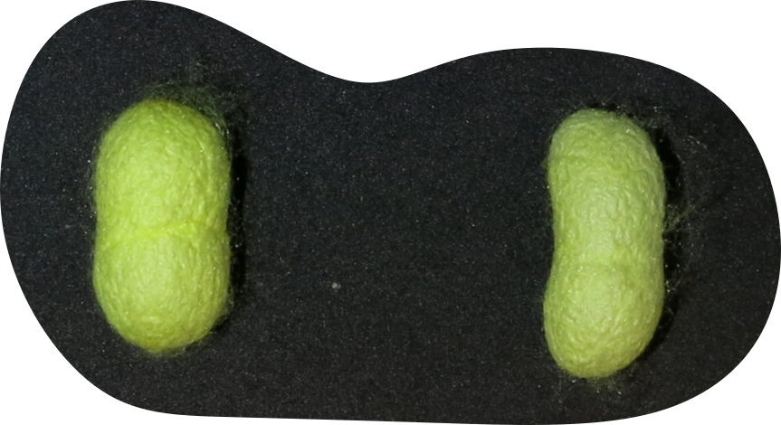
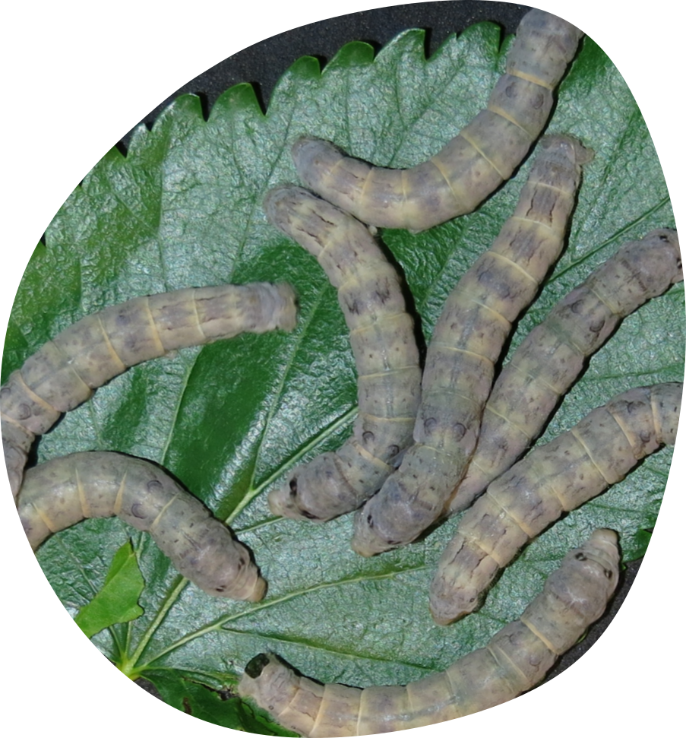
Old Traditional strains - acclimatised in Italy before 1970
This section includes
strains that were traditionally reared in Italy prior to 1900
those acclimatised in Italy since the first half of the 20th century.
They originate from the Middle East, China, Japan and Greece.
Bianca Italia
Almeria
Verde cinturato
32
BS 16
Gibbosi
Abruzzo

Slide 12
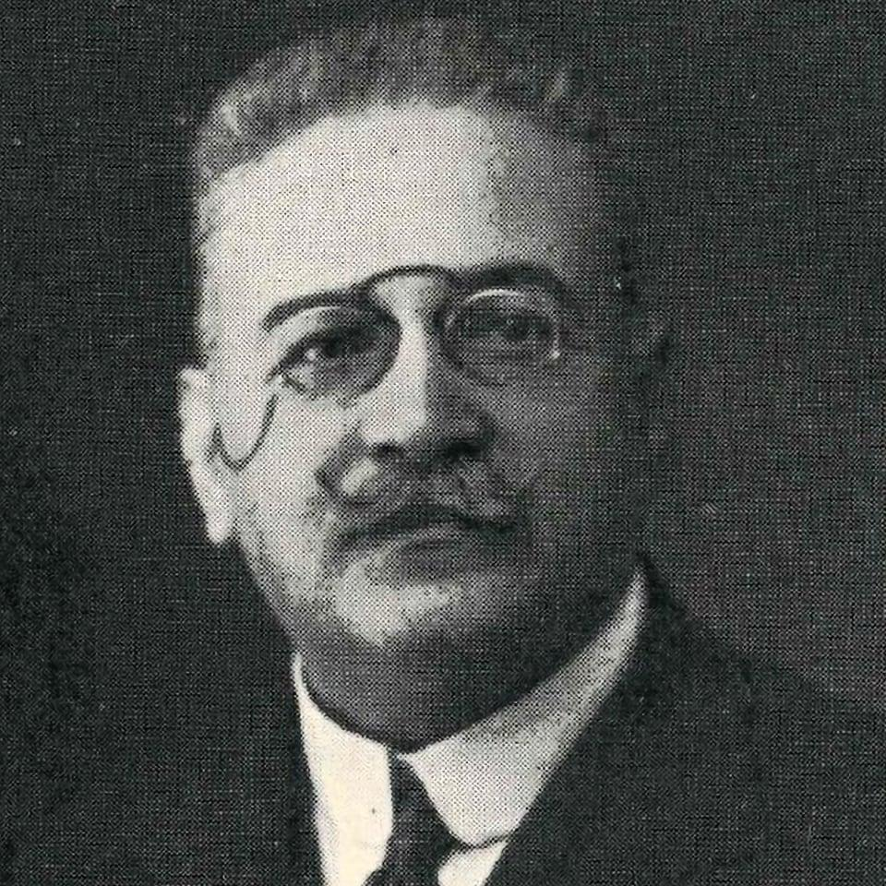
“Mari” strains
Seven silkworm strains were designated with the letter “M”, after Mari.
Benito Manlio Mari (1874 – 1956) was an Italian entrepreneur and expert in the silk sector.
To counter the decline of silk industry, in 1931 he convened the representatives of all Italian silkworm breeding establishments to found the Italian Consortium of Silkworm Egg Producers.
Between 1932 and 1937, at the request of the League of Nations, Mari worked as a silk advisor to the Chinese government, where he lived for several years.
During this period, he imported several silkworm strains, which are still identified today by the initial “M”.

Slide 13
Sections of the catalogue
Old Traditional strains - acclimatised in Italy before 1970
Strains obtained by crossing or selection

Slide 14
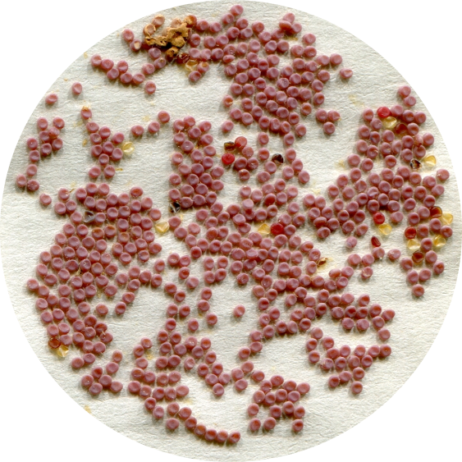
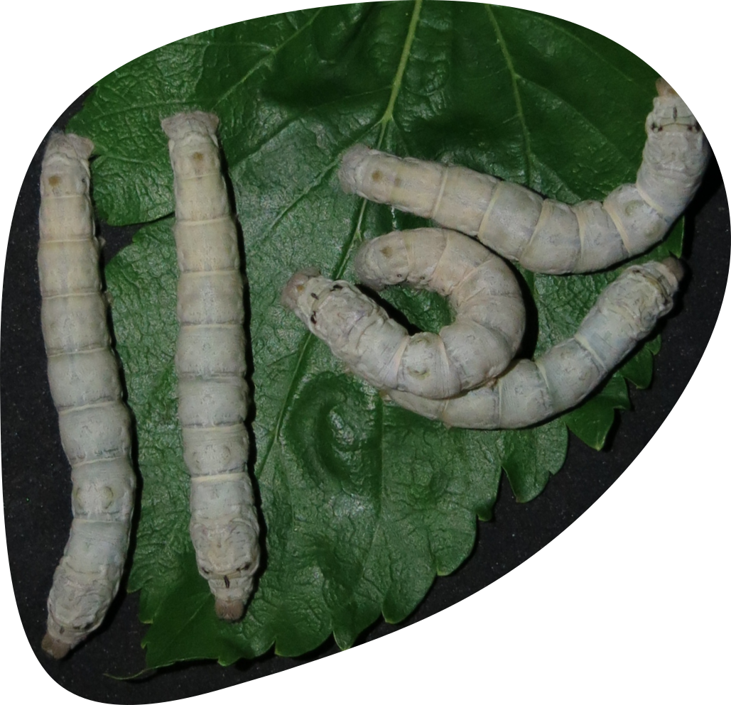
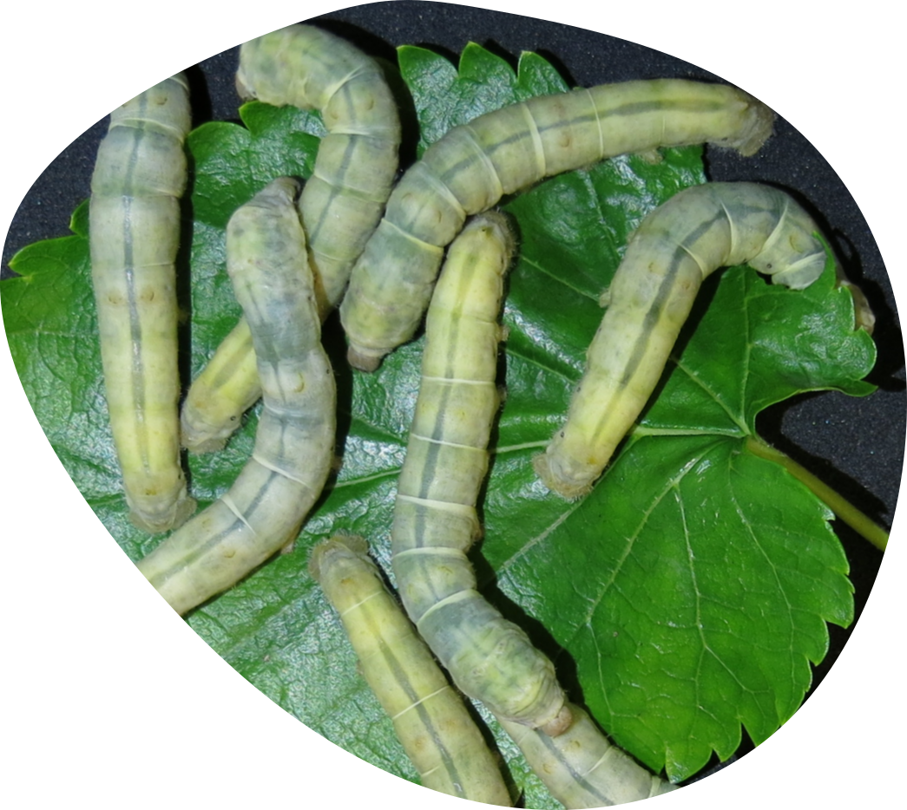
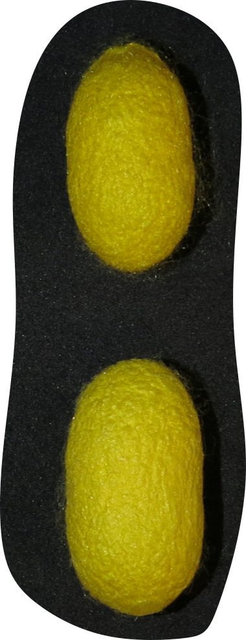
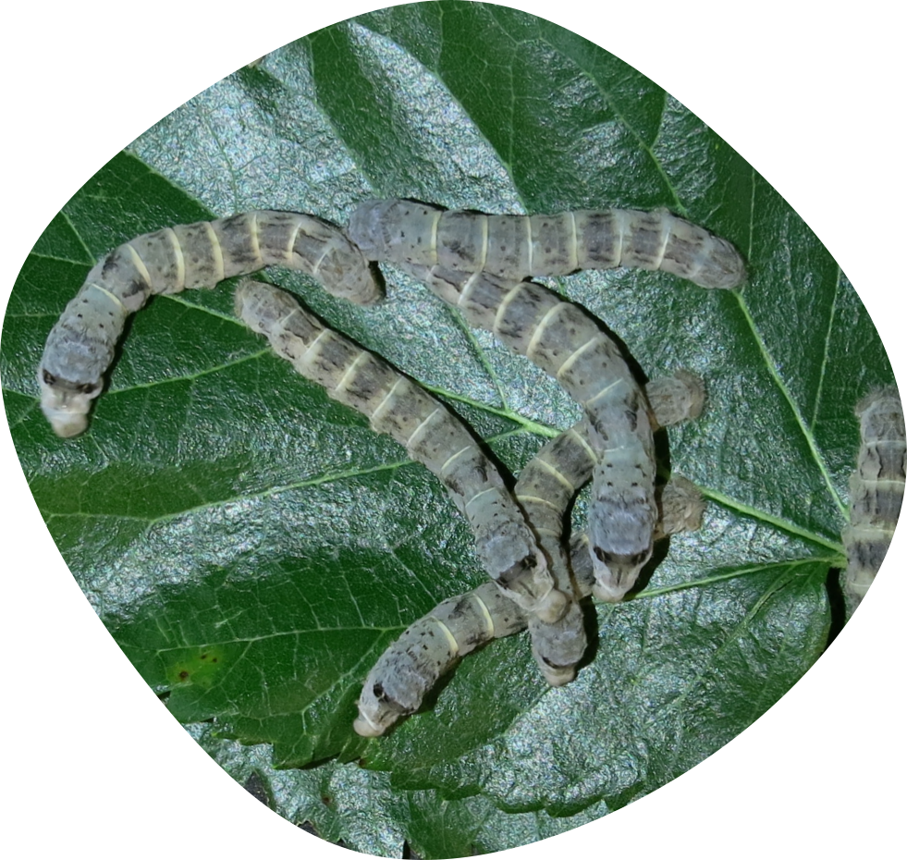
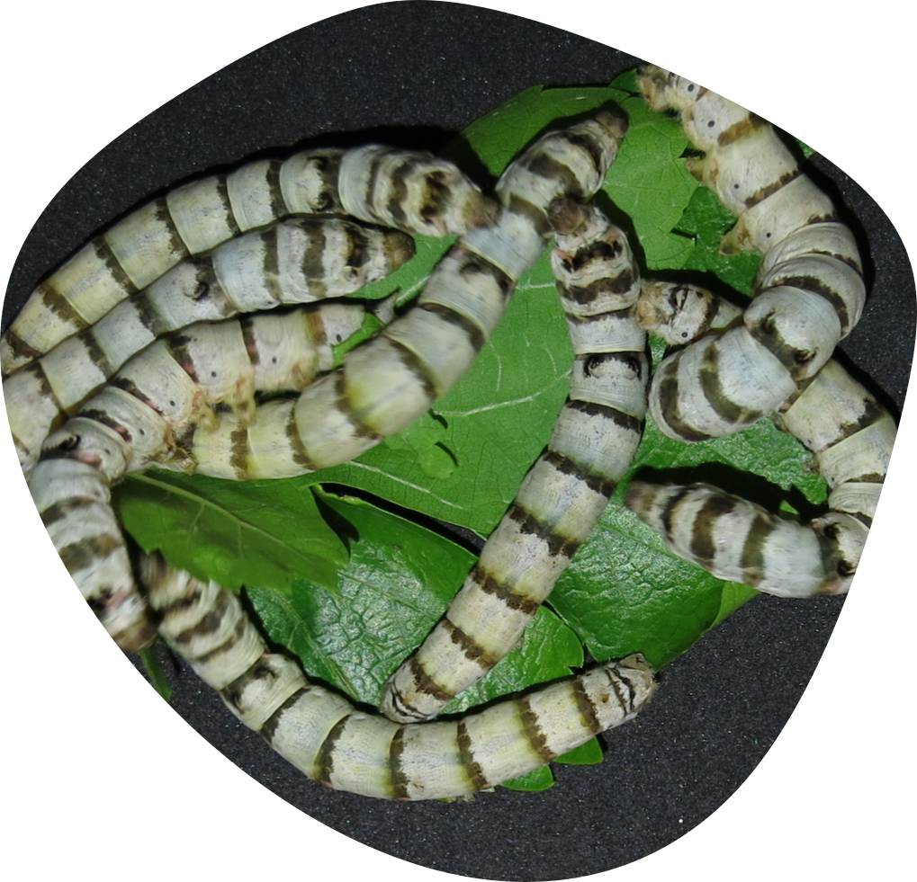
Strains obtained by crossing or selection
Malucelli
This section includes
strains obtained by crossing pure strains
Strain obtained from single mutants that were stabilised over time
Orgosolo giallo
15
Gialla 9/496
SA 15
SA 48 larve verdi

Slide 15
Sections of the catalogue
Old Traditional strains - acclimatised in Italy before 1970
Strains obtained by crossing or selection
Strains obtained by the Spallanzani Institute

Slide 16
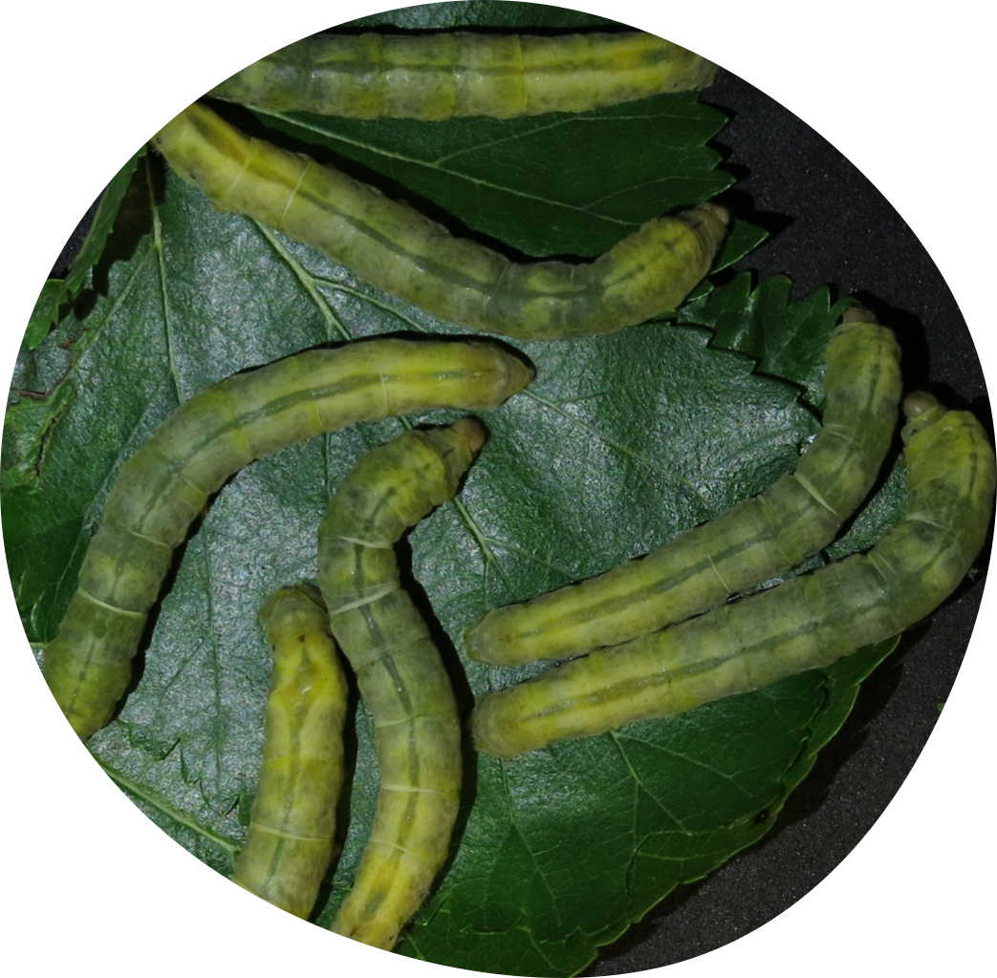
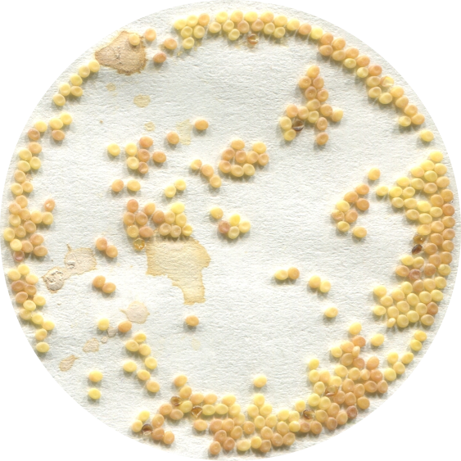
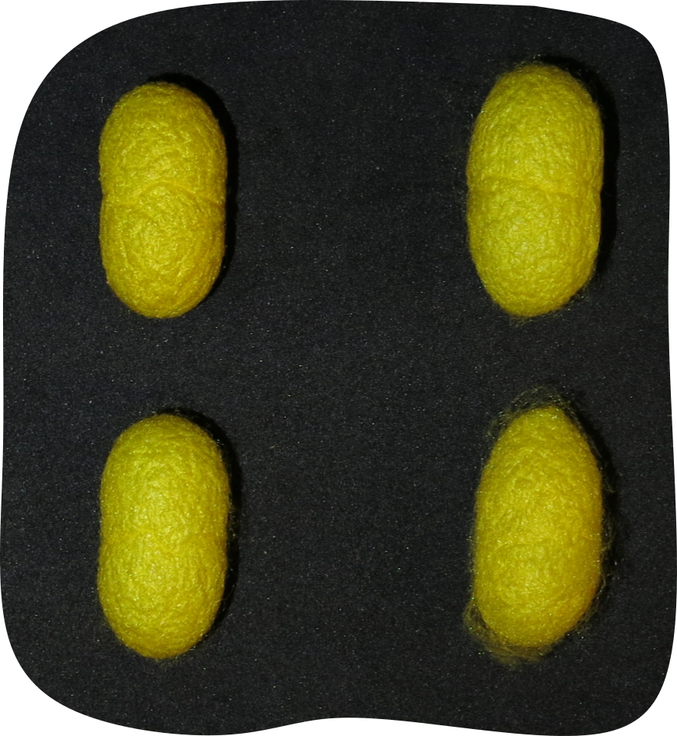
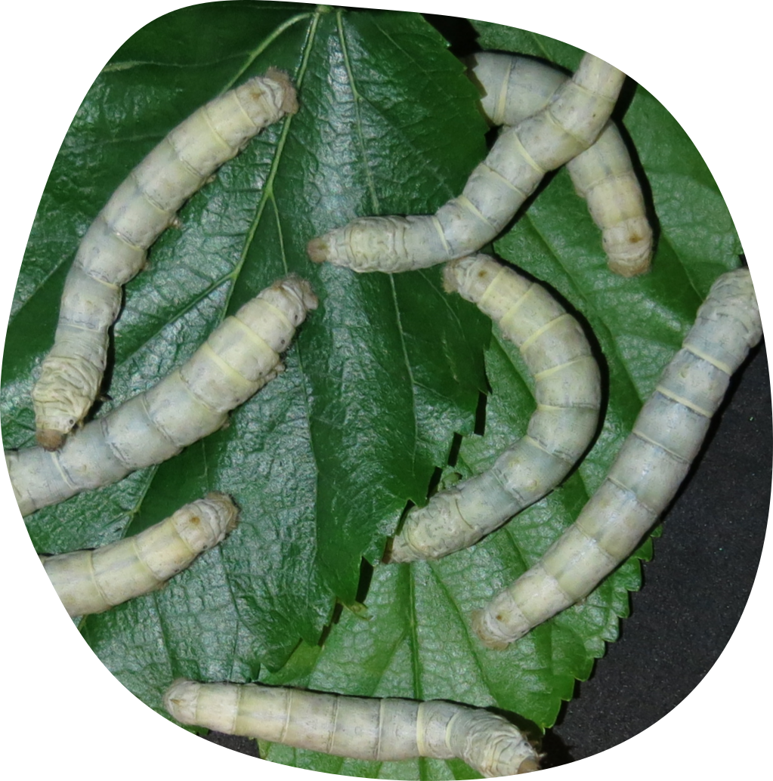
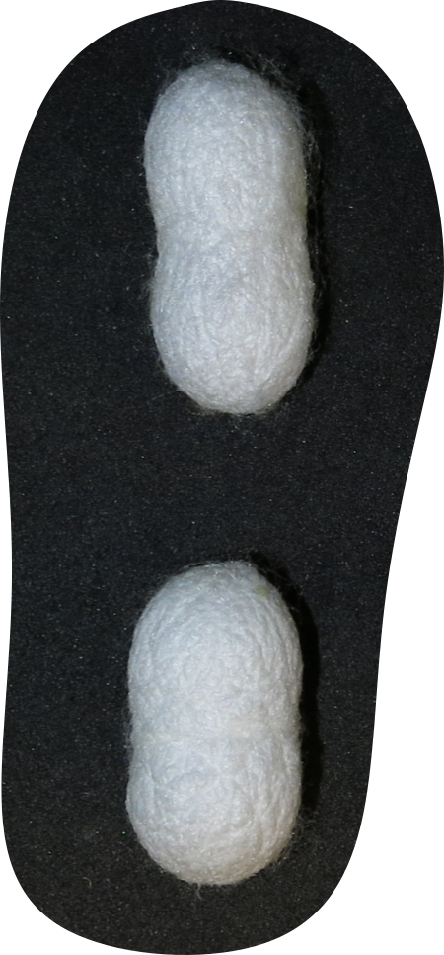
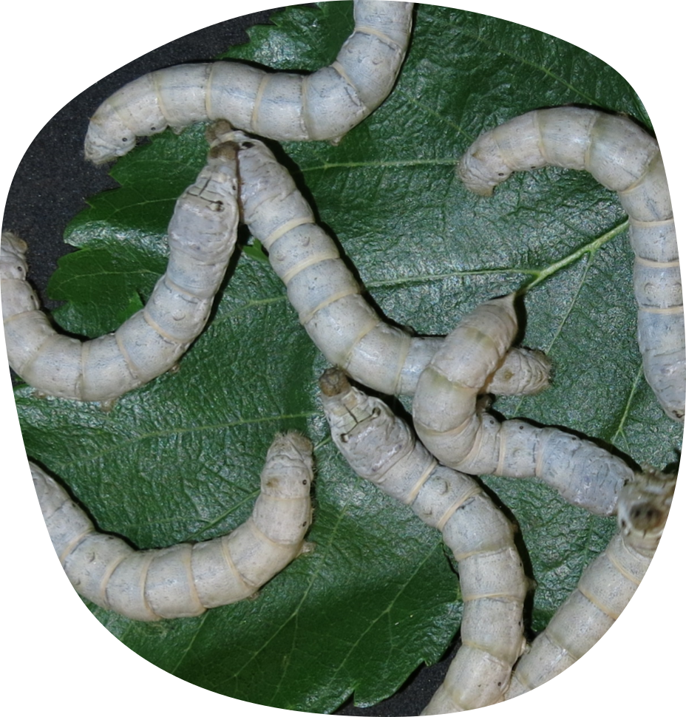
Strains obtained from the Spallanzani Institute
This section includes the strains conserved at the Spallanzani Institute, donated to the Sericulture laboratory of Padova in 1963
7
Albini
Sejaku green
Orgosolo Bianco

Slide 17
Sections of the catalogue
Old Traditional strains - acclimatised in Italy before 1970
Strains obtained by crossing or selection
Strains obtained by the Spallanzani Institute
Strains from San Giacomo di Veglia reproduction centre

Slide 18
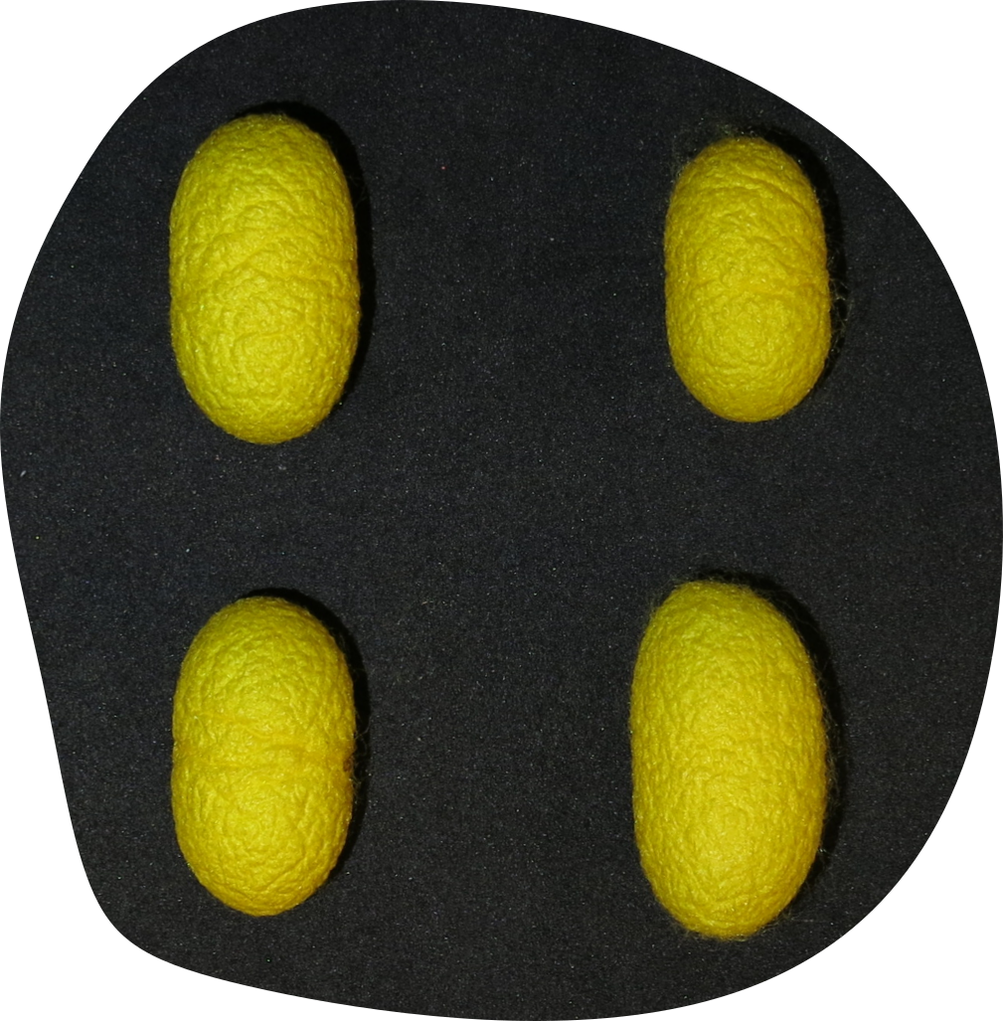
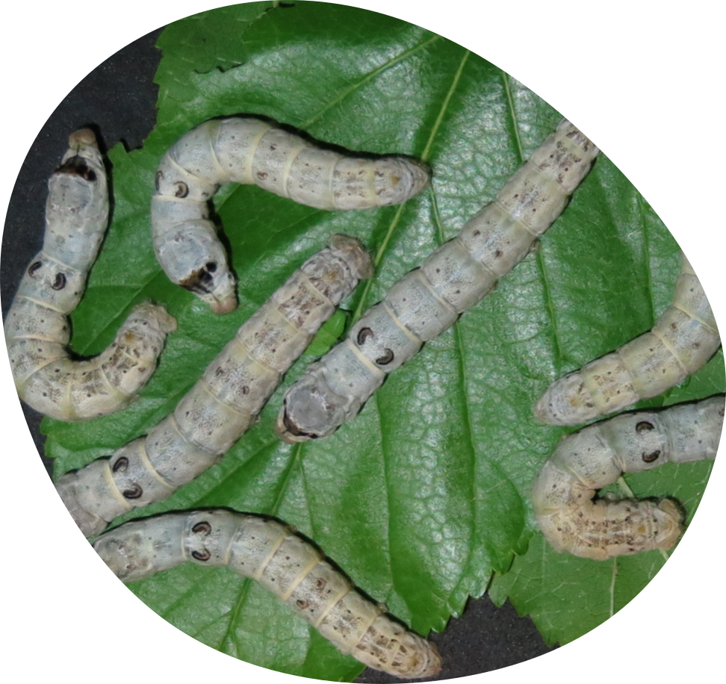
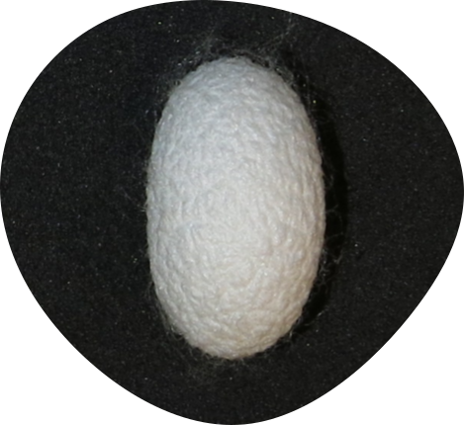
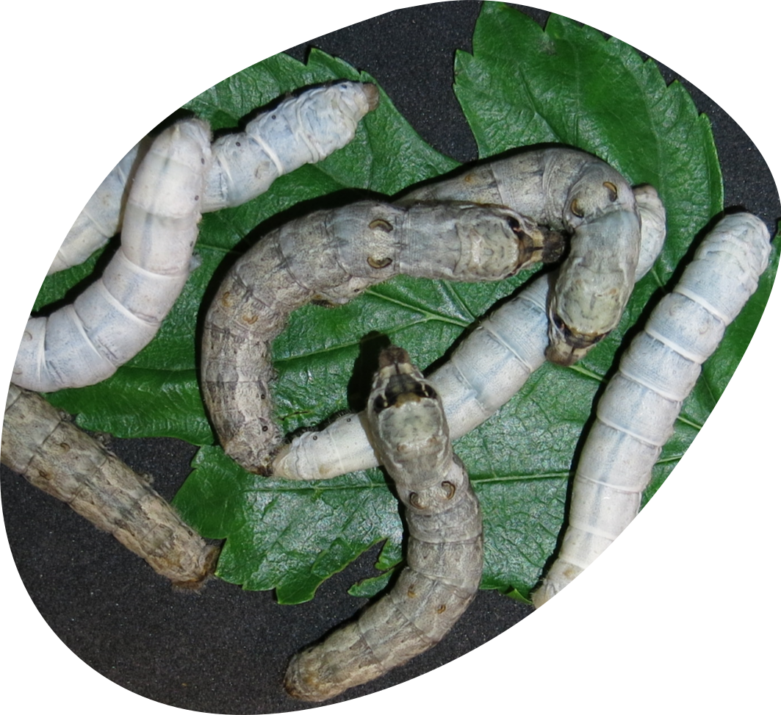
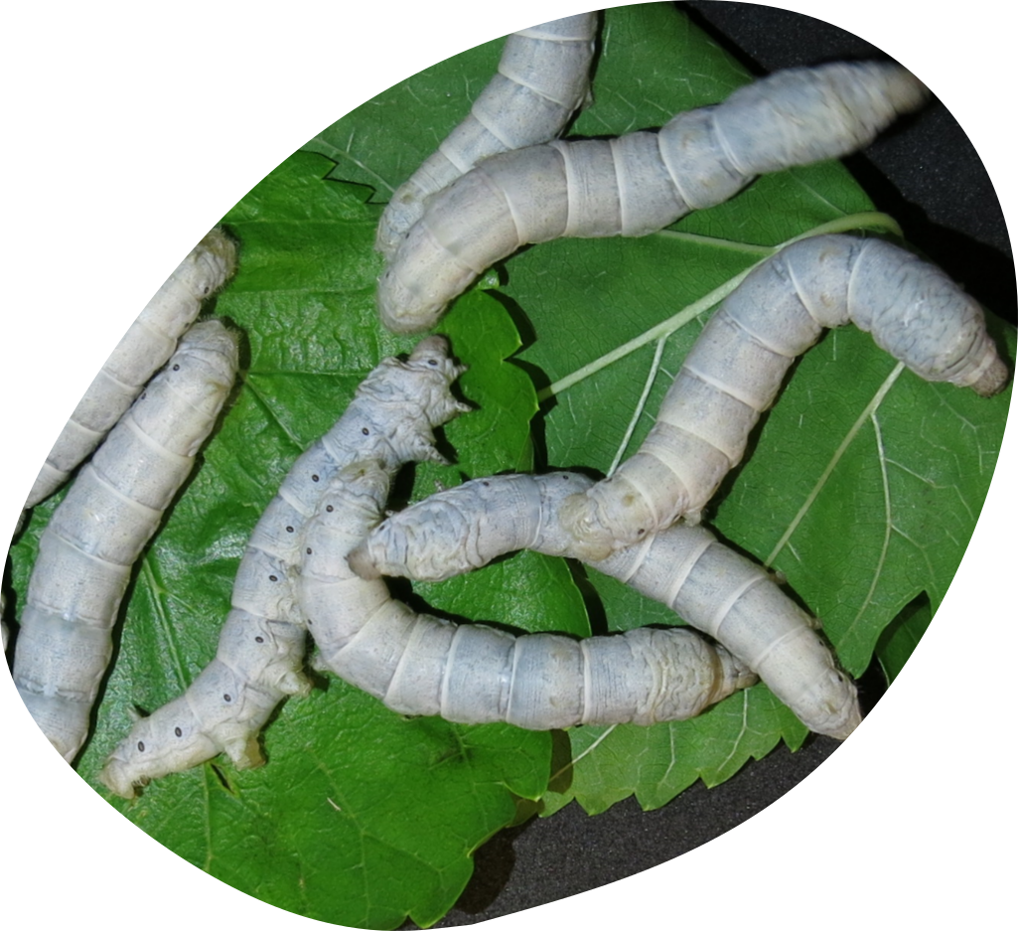
Strains from the Centre for egg production of San Giacomo di Veglia
This section includes the strains used at the Centre for “parent” egg production in San Giacomo di Veglia (Treviso, Italy). Transferred to Padova in 1979.
33
R 3G
BC 17
RC 33

Slide 19
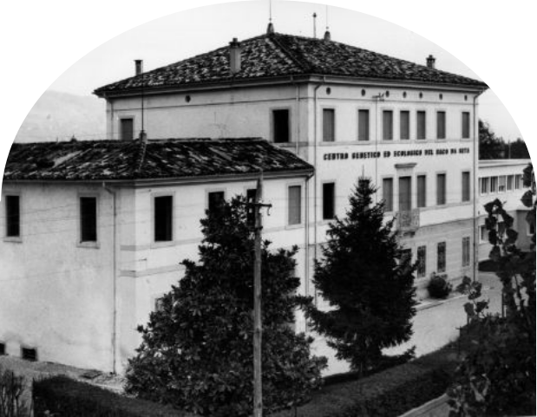
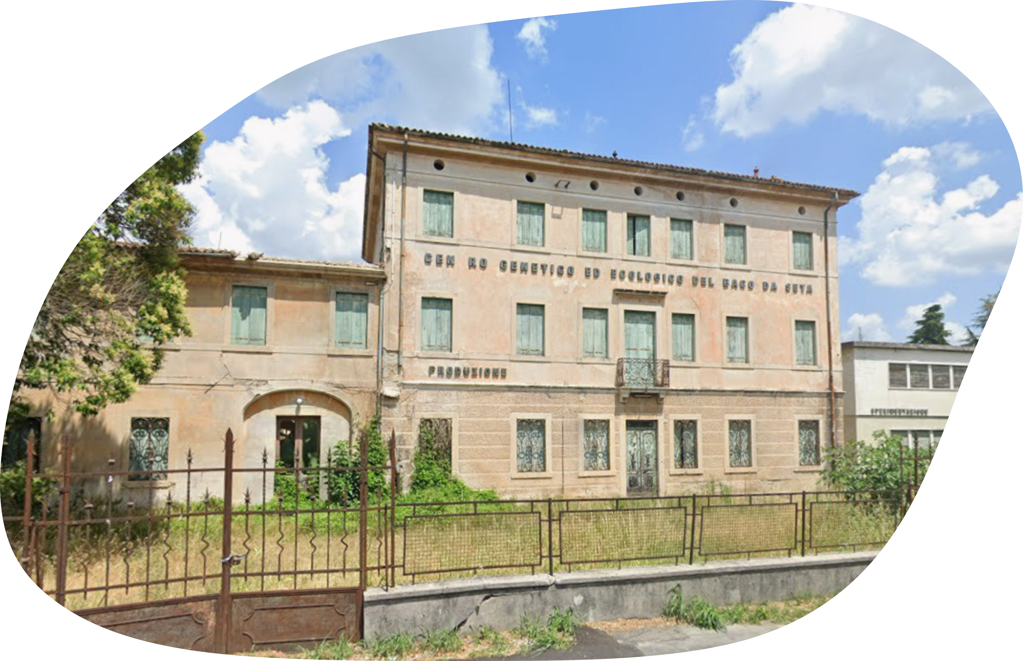
The Centre for egg production of San Giacomo di Veglia (1955 -1978)
The centre was established in 1955 with the tasks of:
reproducing polyhybrid silkworm seed imported from Japan
selecting pure strains and multiplying them to obtain the first crosses
These were then transferred to private sericulture facilities, where different polyhybrid combinations were produced to obtain commercial silkworm seed
Permanent closure in 1978

Slide 20
Sections of the catalogue
Old Traditional strains - acclimatised in Italy before 1970
Strains obtained by crossing or selection
Strains obtained by the Spallanzani Institute
Strains from San Giacomo di Veglia reproduction centre
Strains of unknown origin

Slide 21
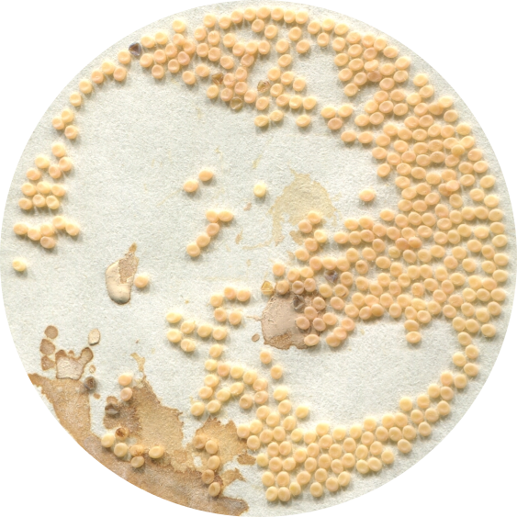
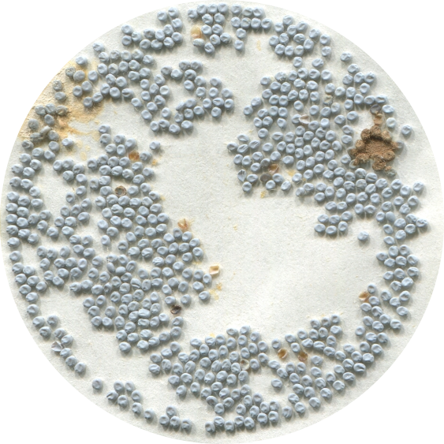
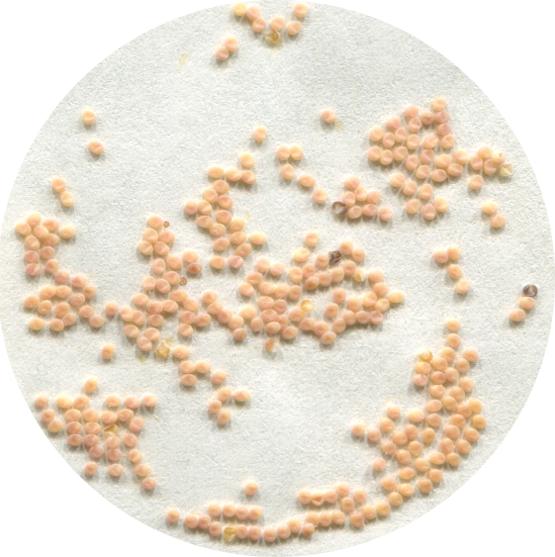
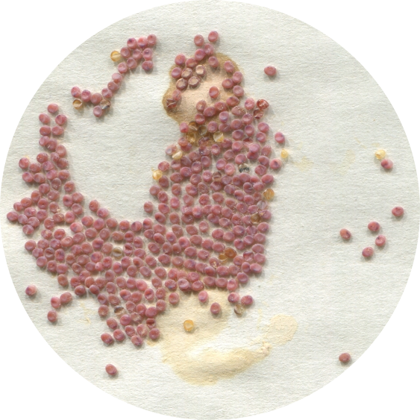
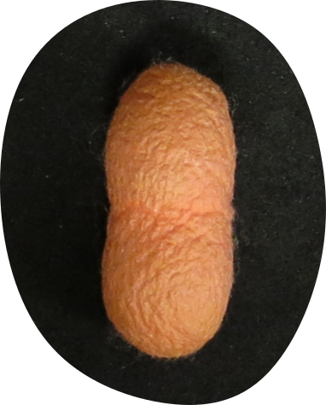
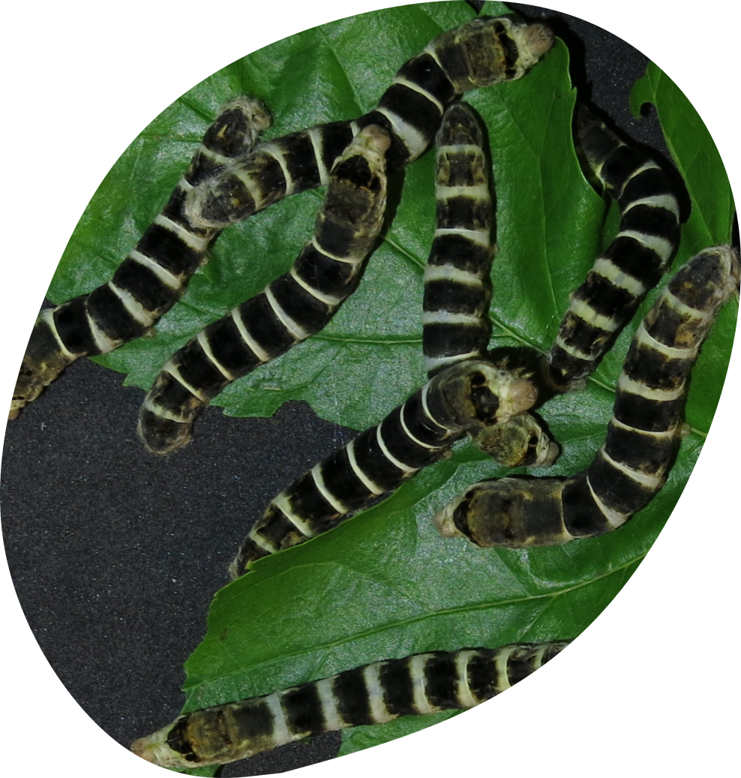
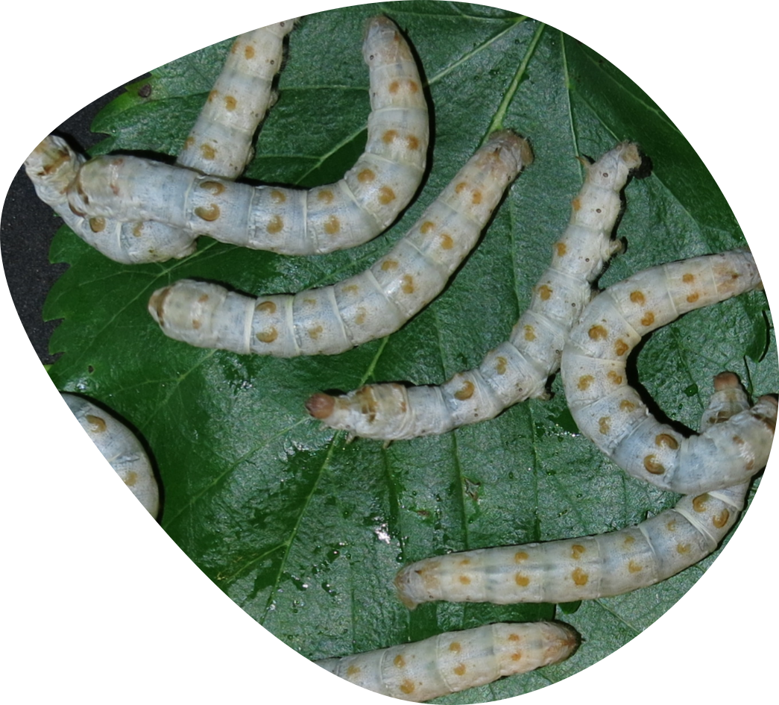
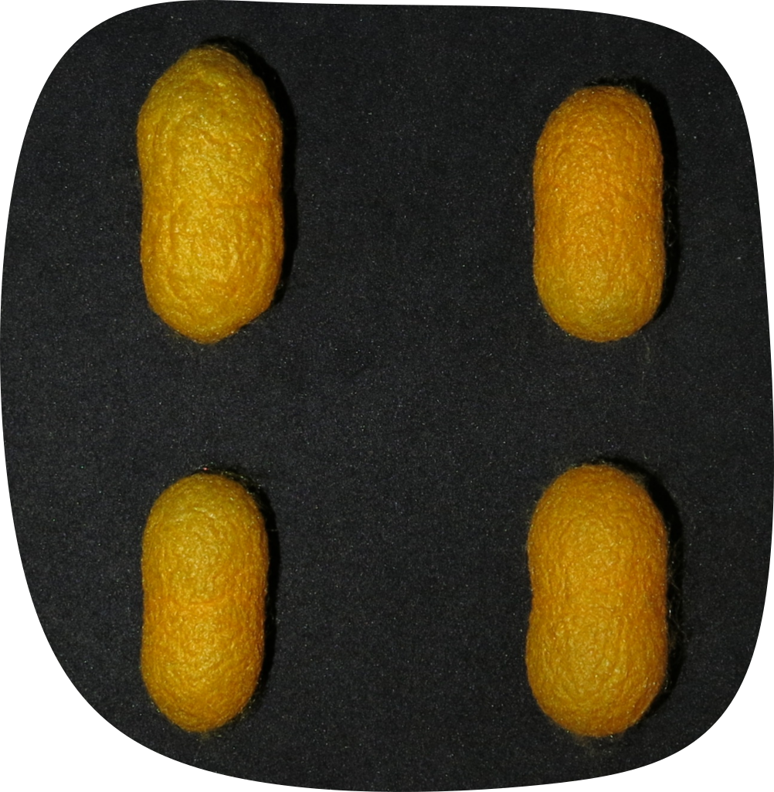
B ceppi uova trasparenti
Strains of unknown origin
This section includes strain of unknown or uncertain origin, for which no historical evidence is available.
They have been preserved due to their unique characteristics.
628 scanalato
16
R9 Neri BP
B uova rosse
B uova gialle
Rosa
Arancio

Slide 22
Sections of the catalogue
Old Traditional strains - acclimatised in Italy before 1970
Strains obtained by crossing or selection
Strains obtained by the Spallanzani Institute
Strains from San Giacomo di Veglia reproduction centre
Strains of unknown origin
Strains acquired after 1990 and derived

Slide 23
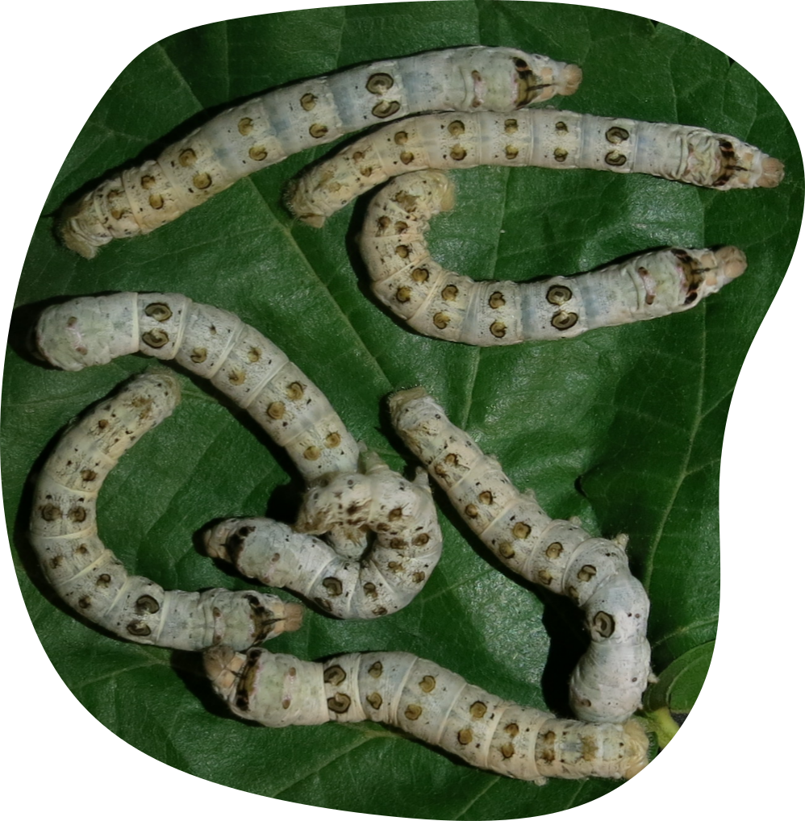
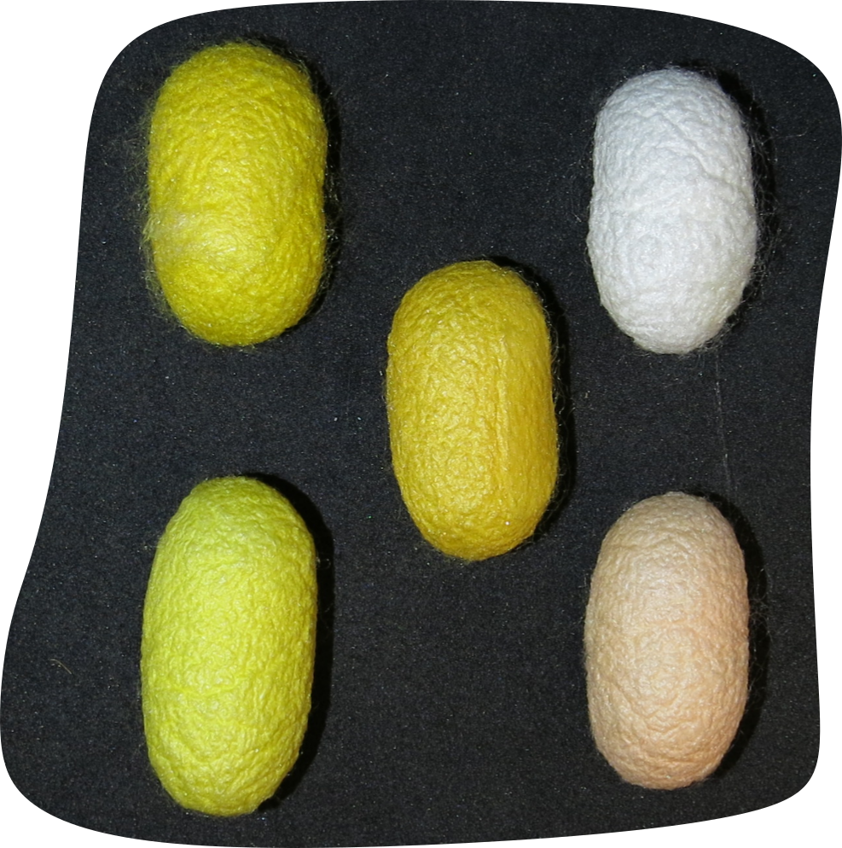
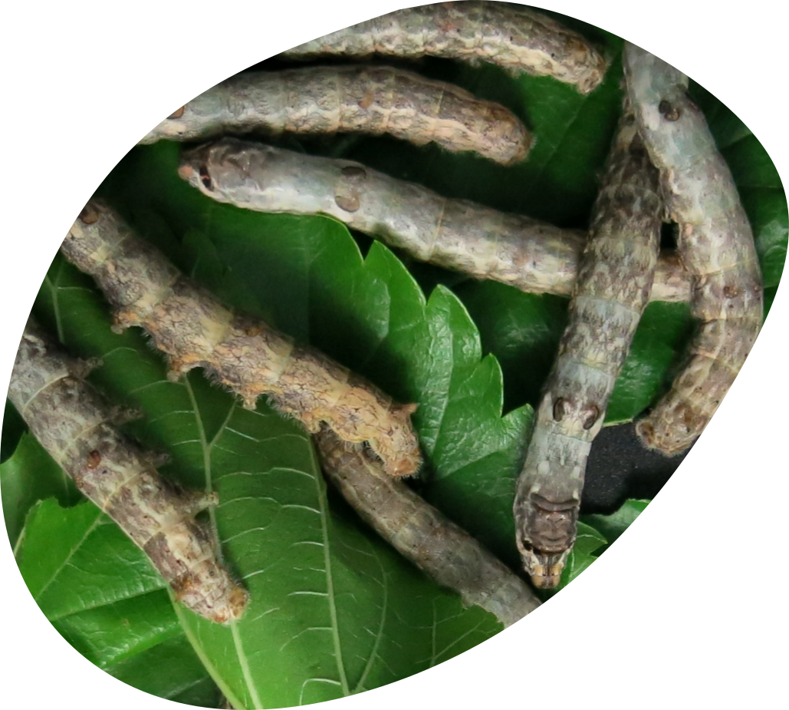
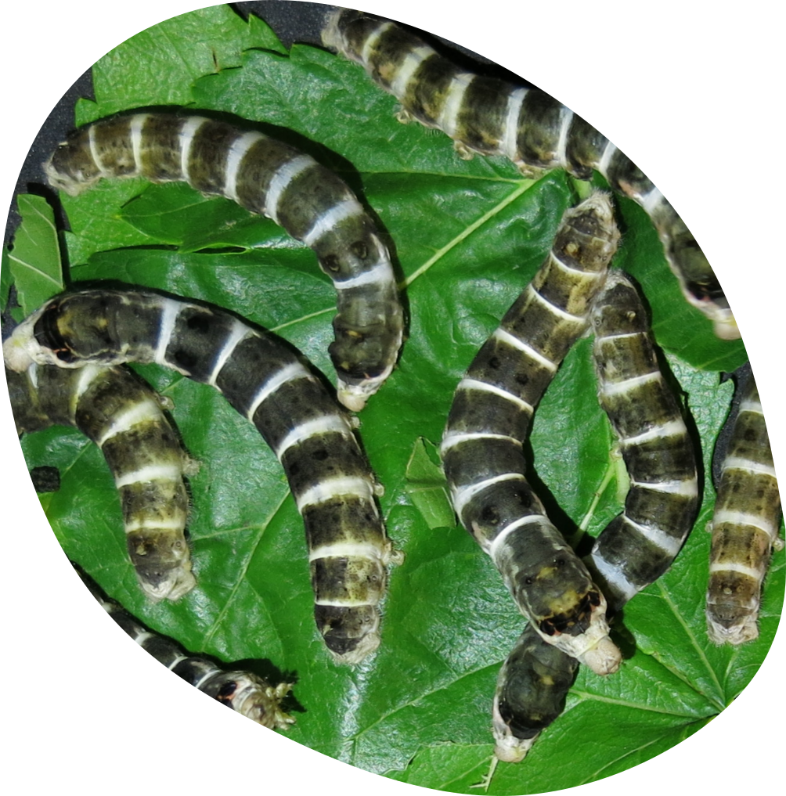
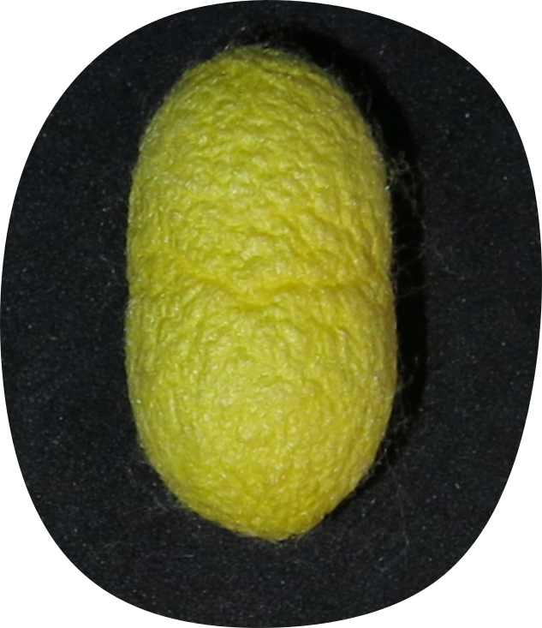
Strains acquired after 1990 and derived
This section includes
strains imported after 1990 and derived
Imported by the National Rearers Association, donated by other sericulture stations or obtained from breeders
27
Turco multistar
Mexico
Ascoli
Baco moro

Slide 24

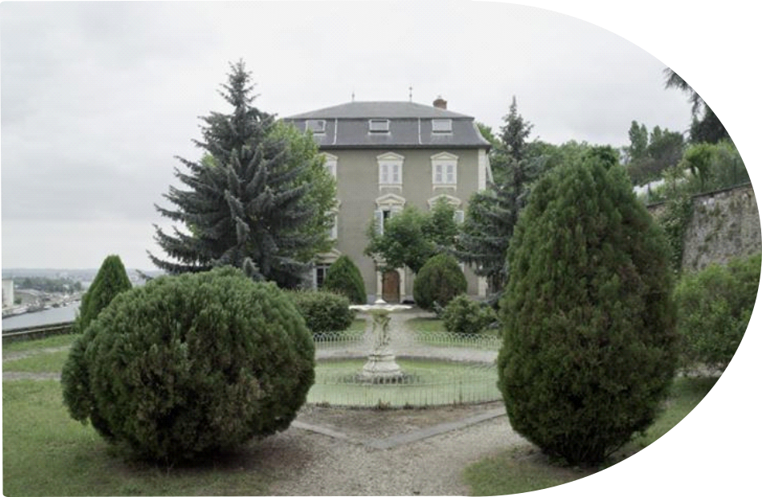
L’Unité Nationale Séricicole de La Mulatière (1979-2009)
The UNS had preserved all the silkworm breeds collected over time in France and by French researchers
It was closed in 2009
UNS entrusted all its assets to the Sericulture Laboratory of Padova through a deposit contract

Slide 25
Sections of the catalogue
Old Traditional strains - acclimatised in Italy before 1970
Strains obtained by crossing or selection
Strains obtained by the Spallanzani Institute
Strains from San Giacomo di Veglia reproduction centre
Strains of unknown origin
Strains acquired after 1990 and derived
Strains from the French
national sericulture collection

Slide 26
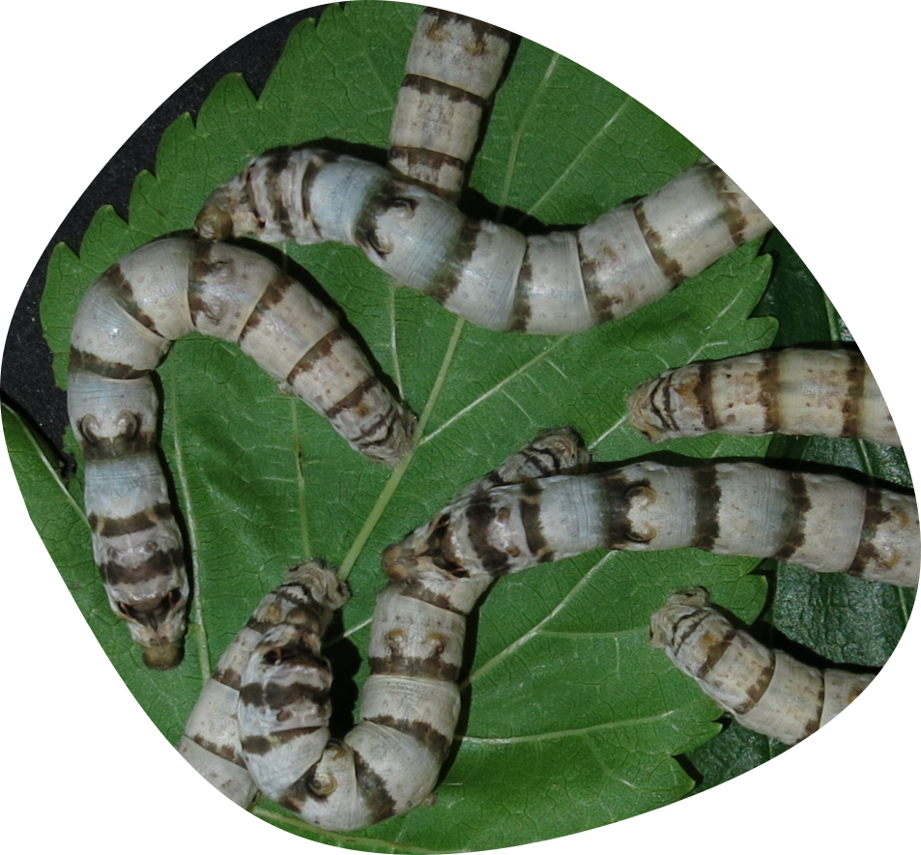
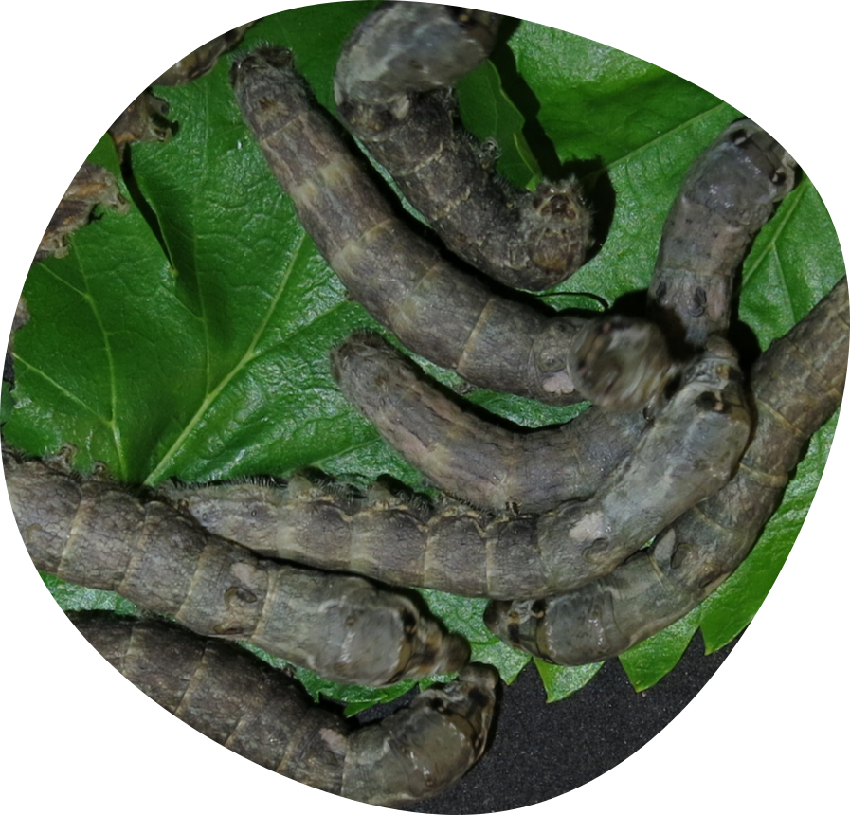



Strains from the French national sericulture collection
BL1D
This section includes all the strains maintained at the Unité Sericicole de La Mulatière (Lyon).
The strains represent the French national collection and includes traditional French strains as well as strains from all over the world.
BL1C
50
LY5
PK11/B
I20

Slide 27






Strains from the French national sericulture collection
K 23
This section includes all the strains maintained at the Unité Sericicole de La Mulatière (Lyon).
The strains represent the French national collection and includes traditional French strains as well as strains from all over the world.
50
K 16
PK 17
B 40

Slide 28


Strain origin
180 strains from all over the world

Slide 29
Conclusions
This is the first time the catalogue has been translated into English and made available to the international research community
The catalogue fits within the framework of the ARACNE project, as it contributes to the rediscovery and enhancement of cultural heritage
It contributes to understand the biodiversity of the strains preserved in Italy represents the first step toward reviving silk production
Notes:
The historical catalogue of the Sericultural Station has traditionally been intended for internal use only. In this project, we also aimed to develop a modern version of the catalogue that could serve as a dissemination tool for a broader audience, namely, the international scientific community as well as enthusiasts. For this reason, the catalogue has been translated into English.

Slide 30

Thanks
Luca Tassoni
THIS PROJECT IS FUNDED BY THE EUROPEAN UNION’S HORIZON EUROPE RESEARCH AND INNOVATION PROGRAMME UNDER THE GRANT AGREEMENT NO 101095188

