Slide 1
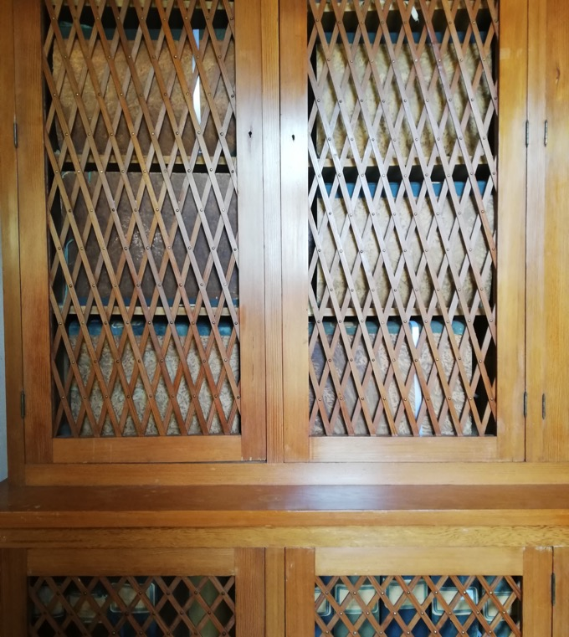
World-Wide Silk Web: the International Sericulture Network
Barbara Di Gennaro Splendore
Notes:
Diapositiva titolo di sezione interna

Slide 2
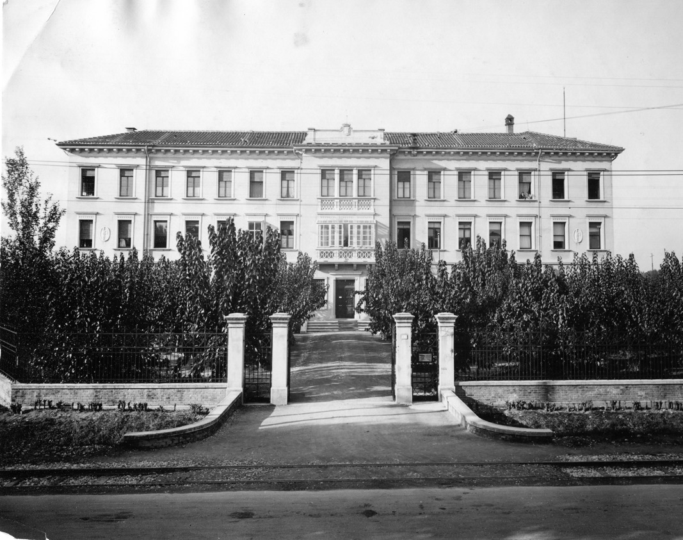
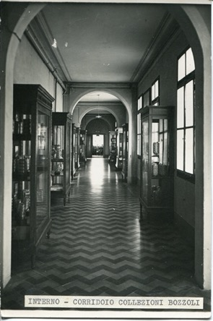
Sericulture Station
1871
1923

Slide 3
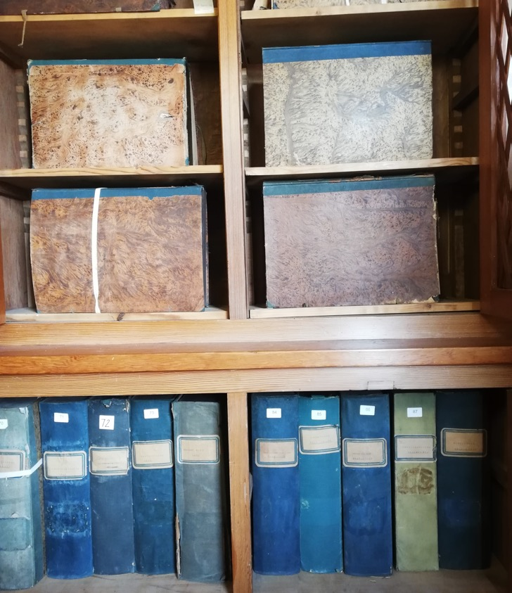
Archive and Library
176 folders containing national and international correspondence, administrative papers, course material, research notes…
About 1000 texts on silk, sericulture and several journals

Slide 4
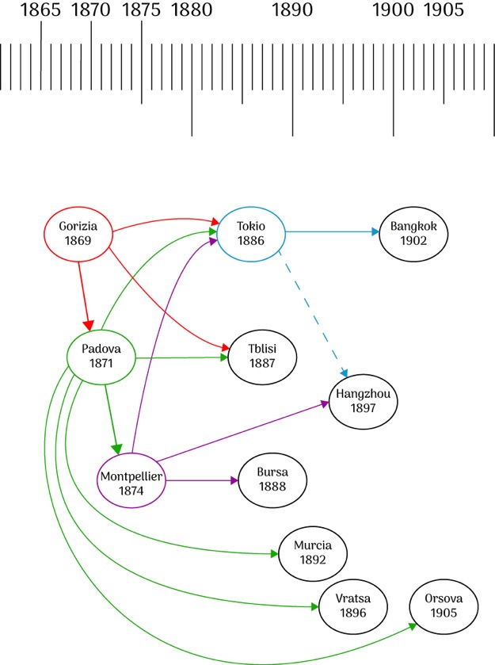

World-Wide Silk Web: the Padua Sericulture Experimental Station and the International Circulation of Techno-Entomology (1896-1900)

Slide 5
Date of Foundation | State | City of first station and current (state)
1869 | Austria-Hungary | Gorizia (Italy)
1871 | Italy | Padua
1871 | Austria-Hungary | Split, Dubrovnik, Rab, Hvar, Skradin, Kotor (Croatia)
1874 | France | Montpellier
1879 | Austria-Hungary | Szekszárd (Hungary)
1884 | Japan | Tokyo
1887 | Russian Empire | Tbilisi (Georgia)
1888 | Ottoman Empire | Bursa (Turkey)
1893 | Spain | Murcia
1894 | Bulgaria | Vratsa
1897 | China | Hangzhou
1902 | Siam | Bangkok (Thailand)
1925 | Romania | Orșova
First Sericulture Stations Established by Country/Polity (1869-1925). In parenthesis, today’s nationality

Slide 6
Letter to Padua’s director Luciano Pigorini from Savvas Pontiki in the Island of Cyprus dated February 22 1933 discussing the global decrease of silk prices.

Slide 7

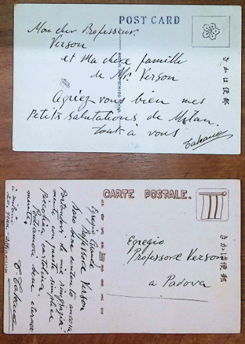
Postcards to Padua’s director Enrico Verson from Taiso(?) Takano travelling in Europe
1924(?)

Slide 8
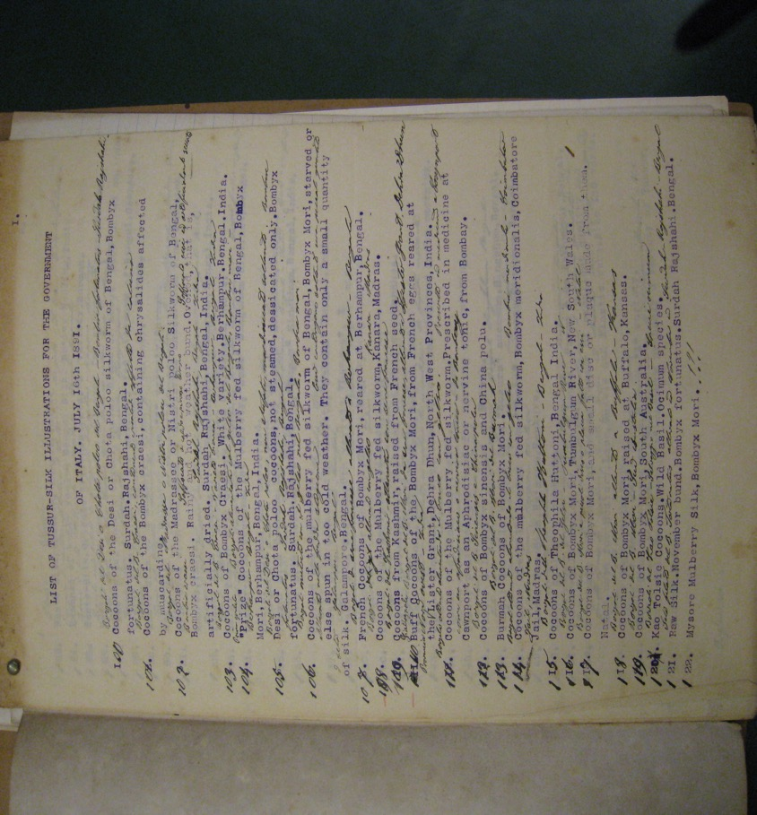
Wardle Collection Catalogue
Correspondence with Thomas Wardle and Muckerji Nitya Gopal from Berhampur
on Tasar silk

Slide 9


Thanks
barbara.dg.splendore@gmail.com
www.aracneproject.eu
THIS PROJECT IS FUNDED BY THE EUROPEAN UNION’S HORIZON EUROPE RESEARCH AND INNOVATION PROGRAMME UNDER THE GRANT AGREEMENT NO 101095188
Notes:
Diapositiva per retro copertina - chiusura presentazione

