Slide 1
ARACNE meeting /
Virtual Silk Exhibition Report
/ WP 2 / T1.4 / D 1.7 & D1.8
Padova, 16-17th February

Slide 2
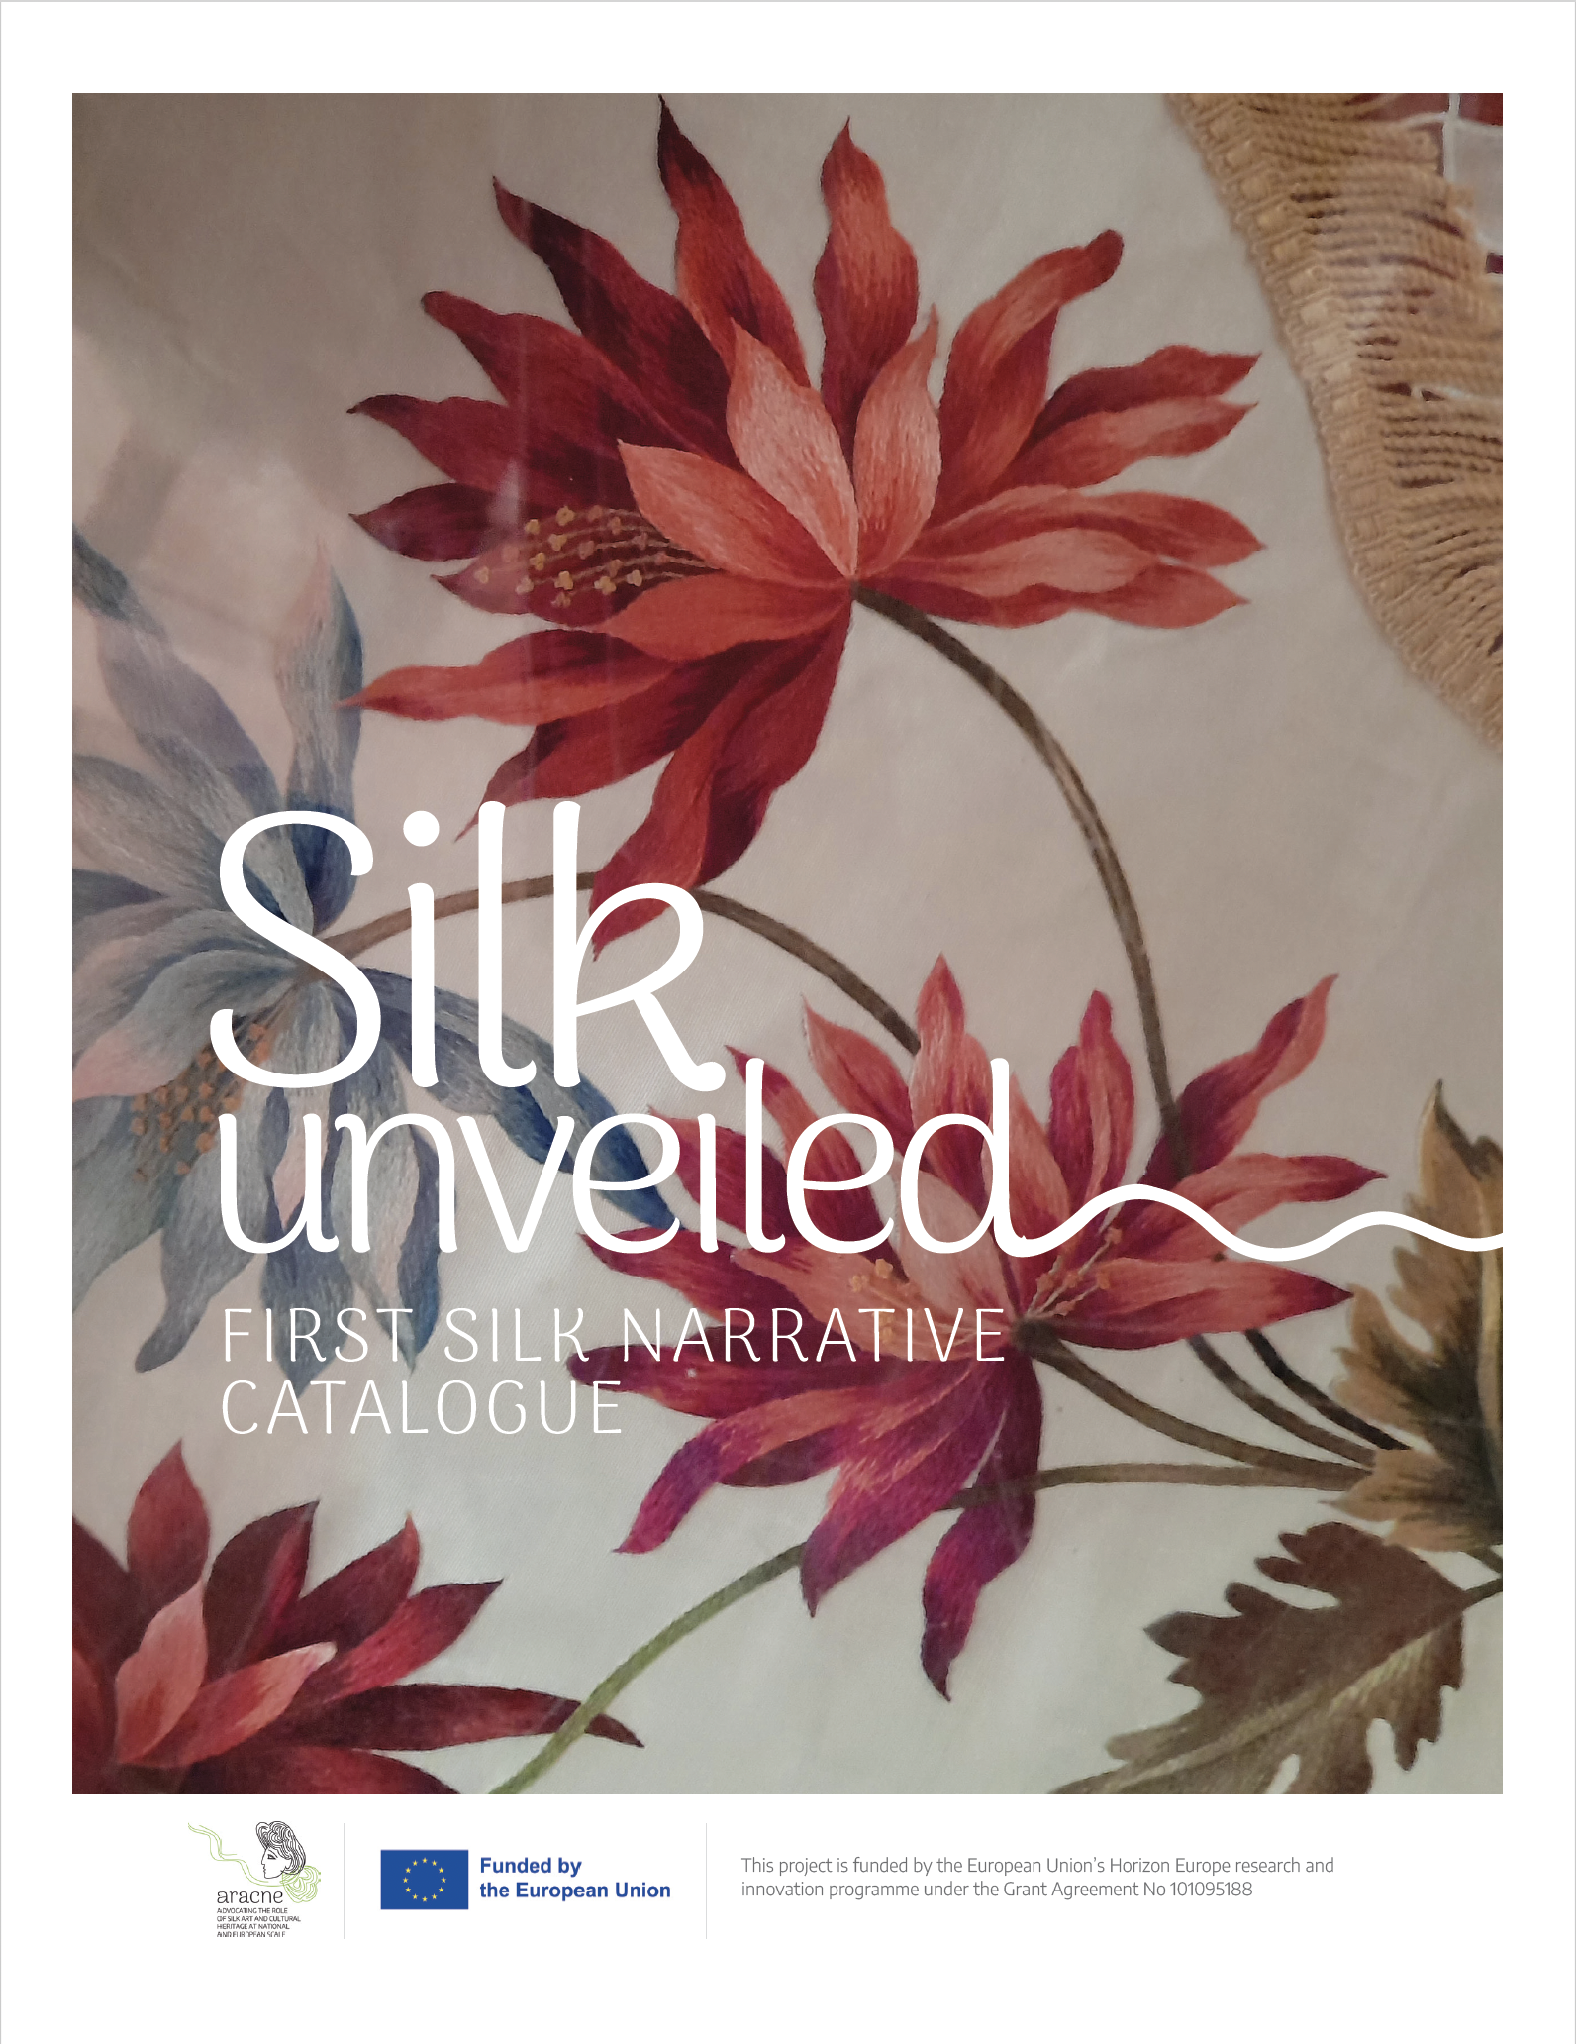
Silk narrative catalogue
/ WP1 / T1.4 / D 1.7 & D1.8
The catalog spans approximately 218 pages:
M12 (D1.7, Silk narrative catalogue v1.0)
M35 (D1.8, Silk narrative catalogue v2.0)

Slide 3
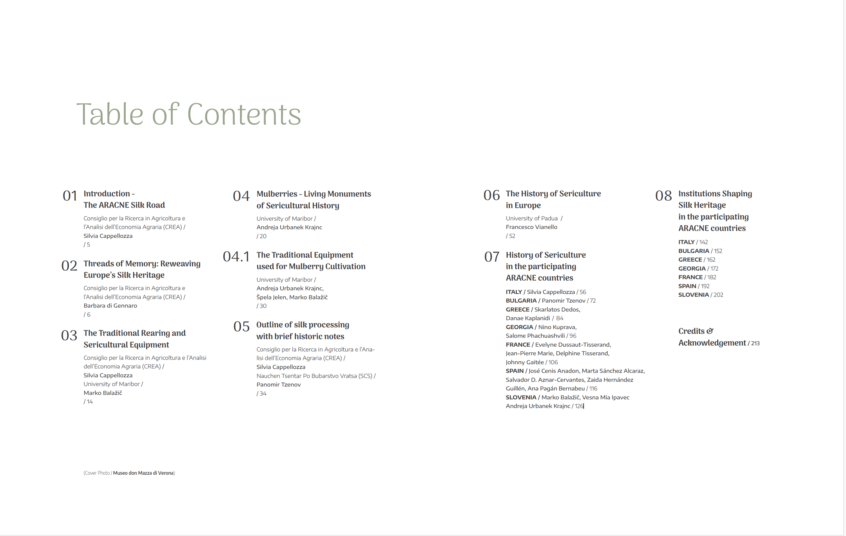
M12 (D1.7, Silk narrative catalogue v1.0)

Slide 4
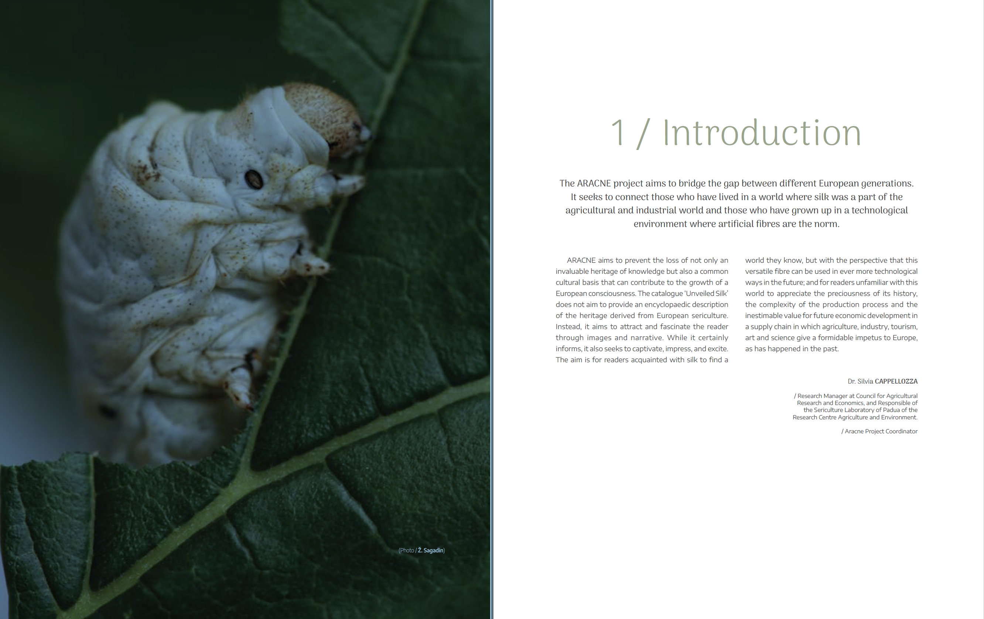

Slide 5
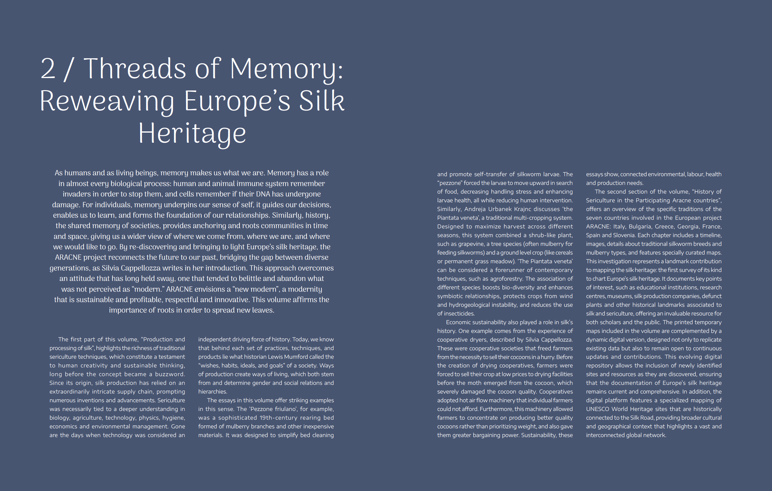

Slide 6
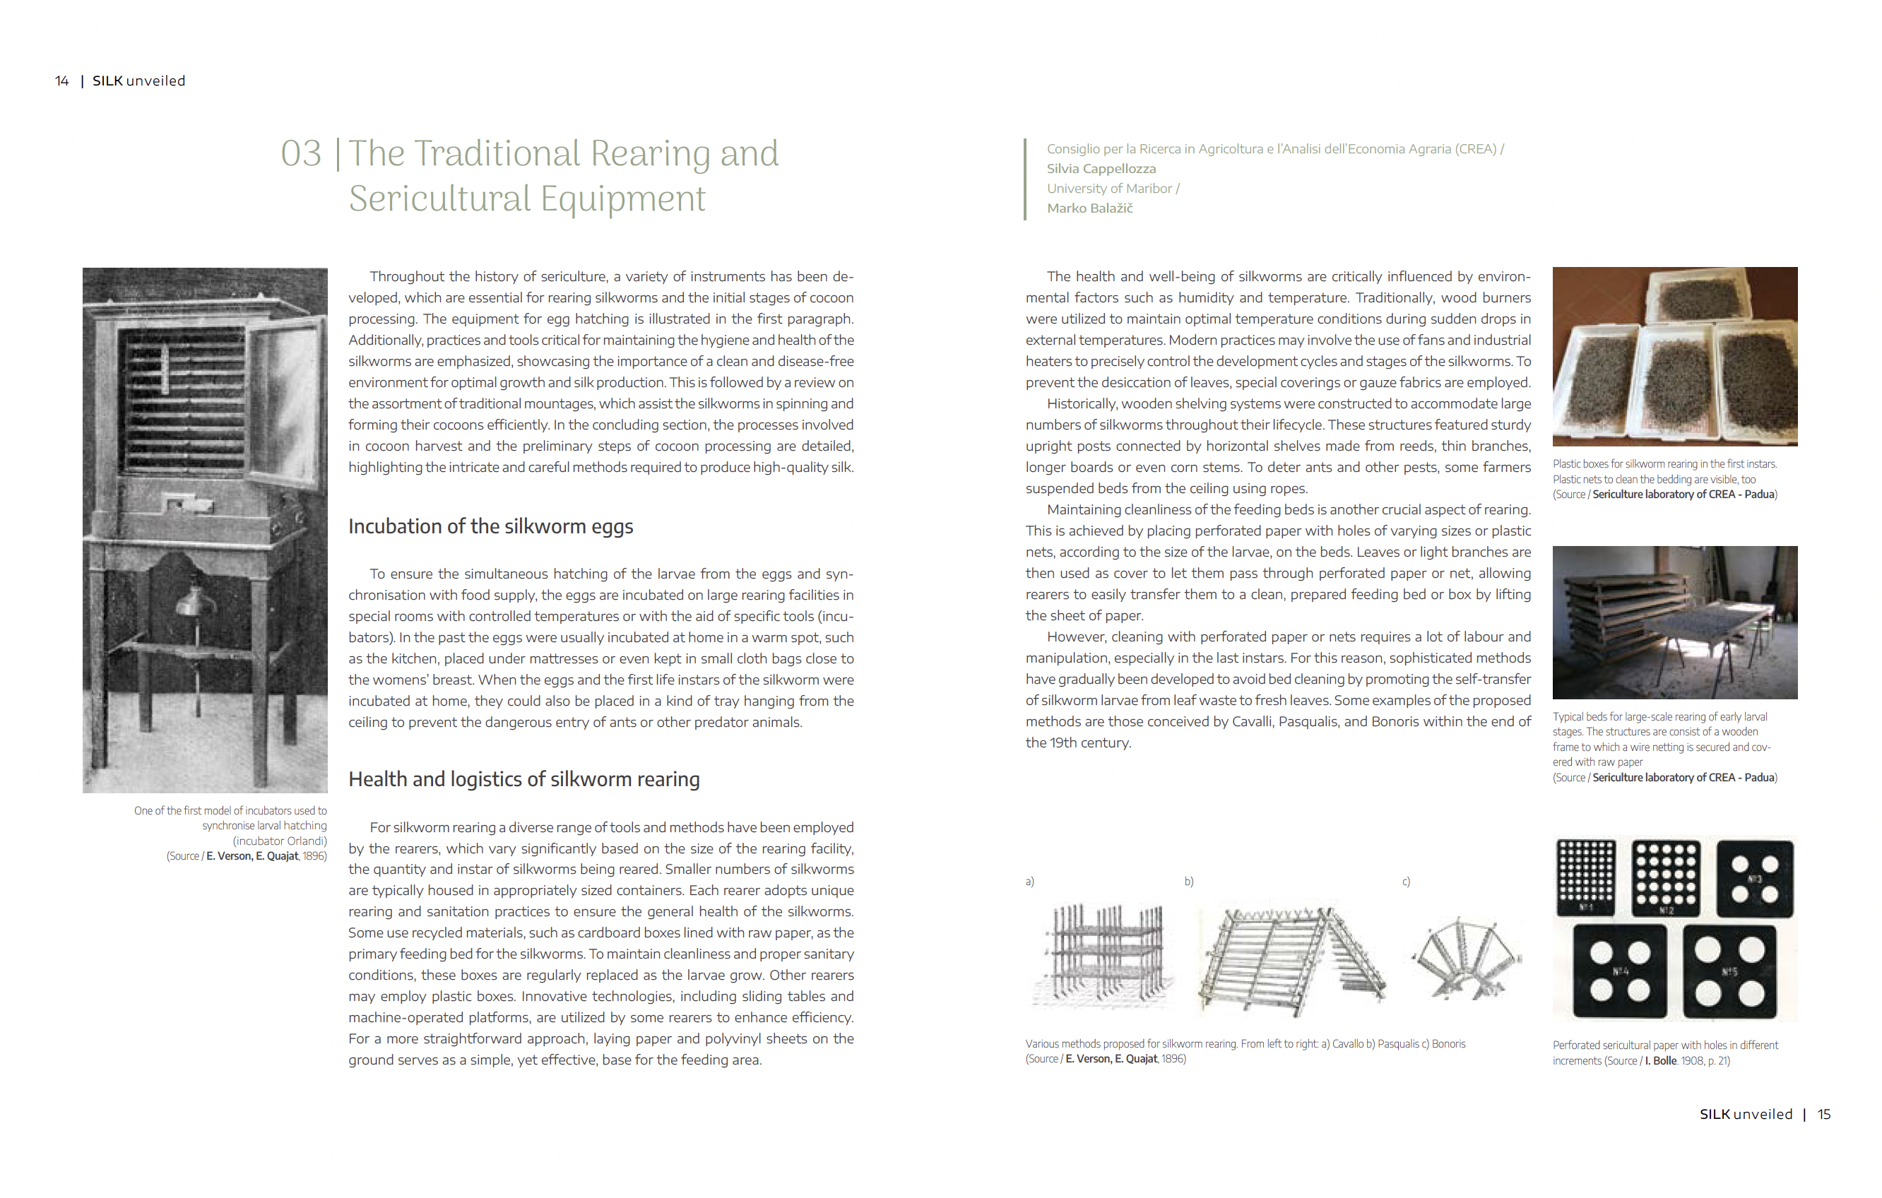

Slide 7
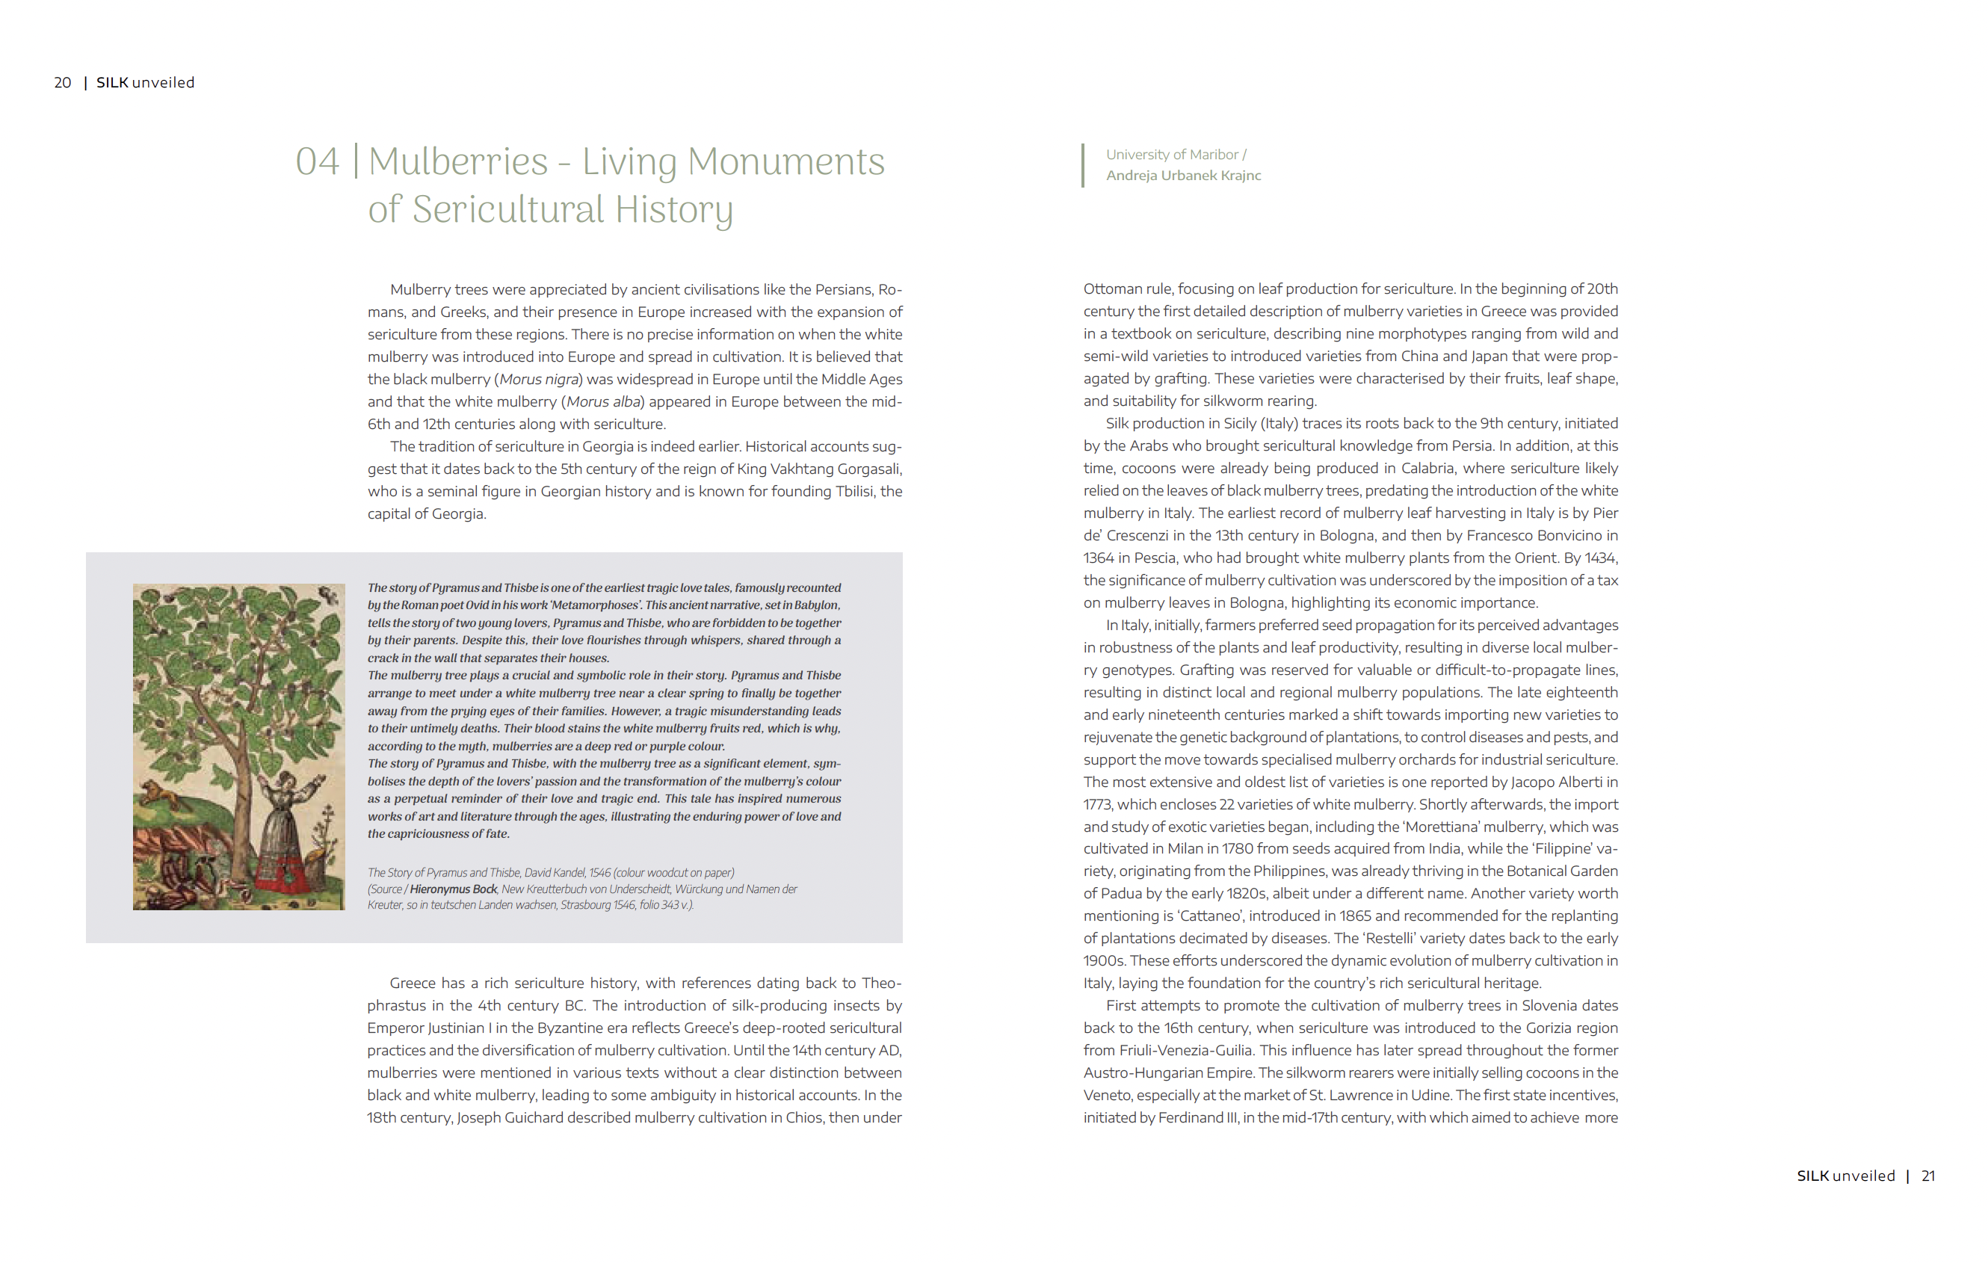

Slide 8
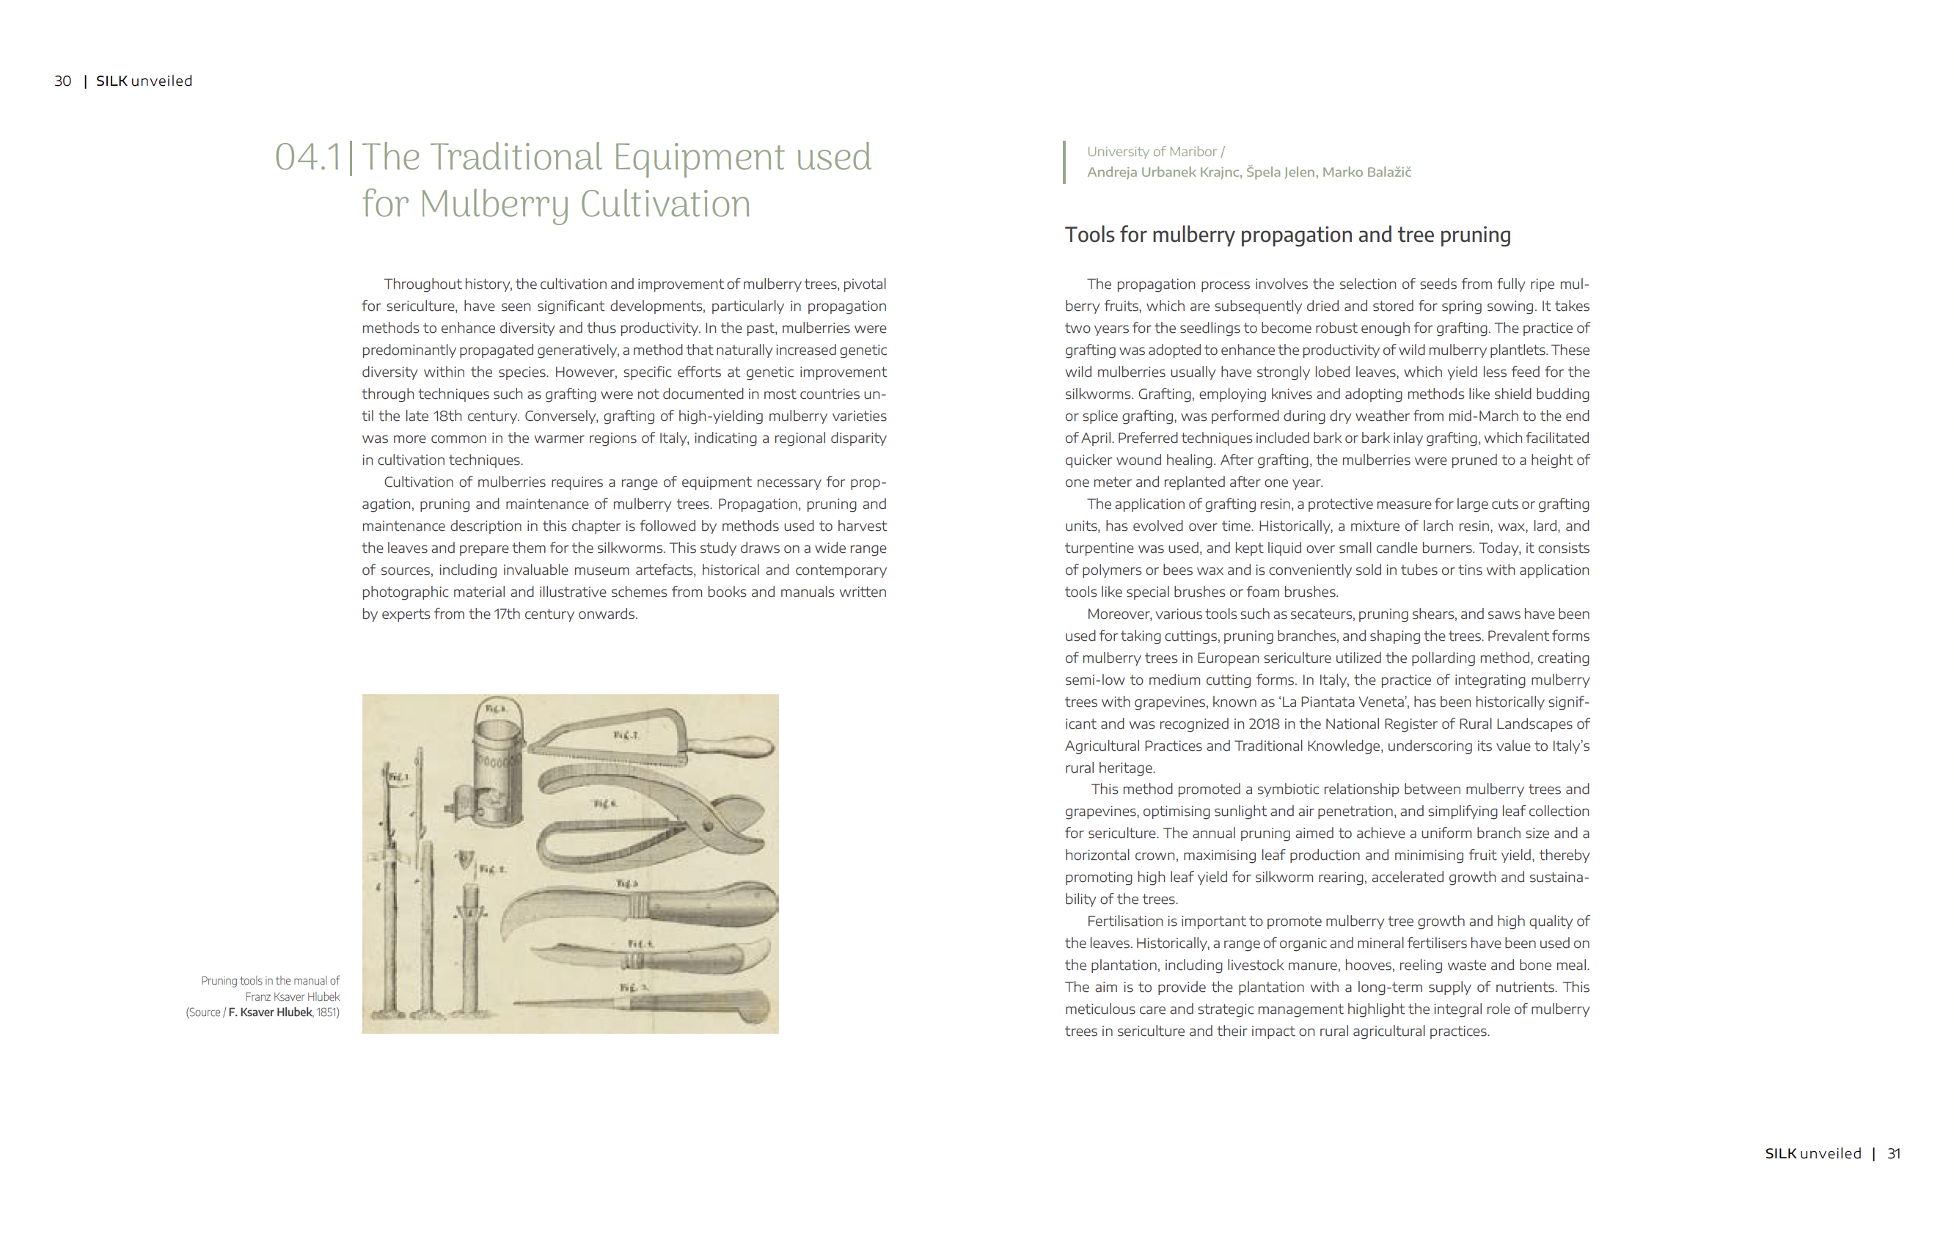

Slide 9
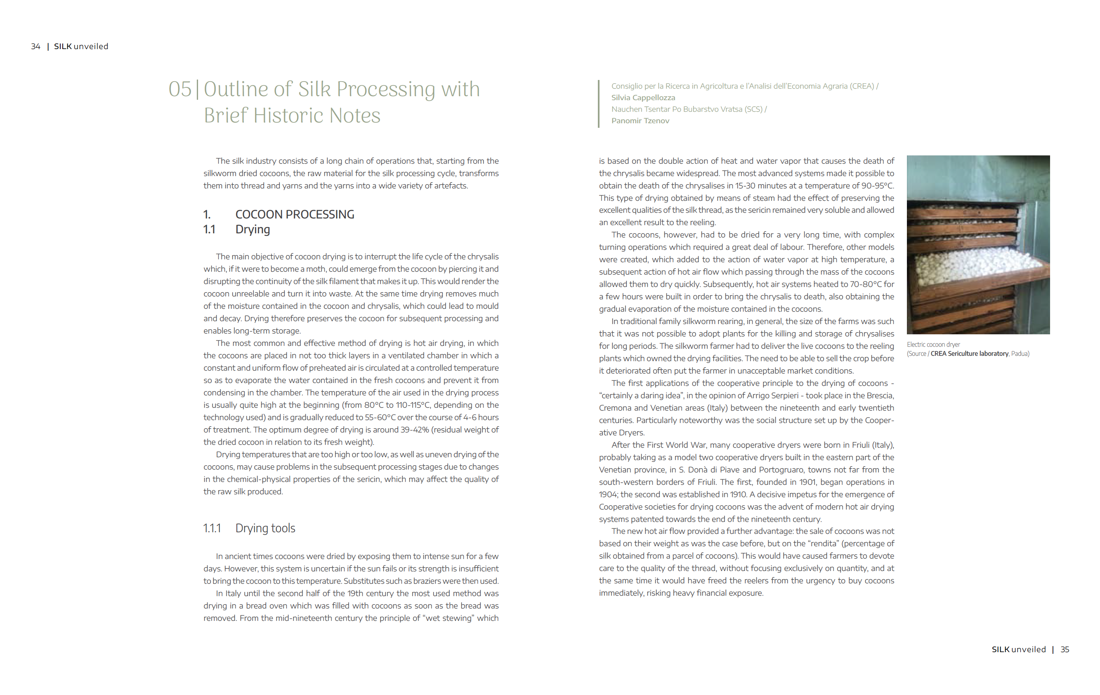

Slide 10
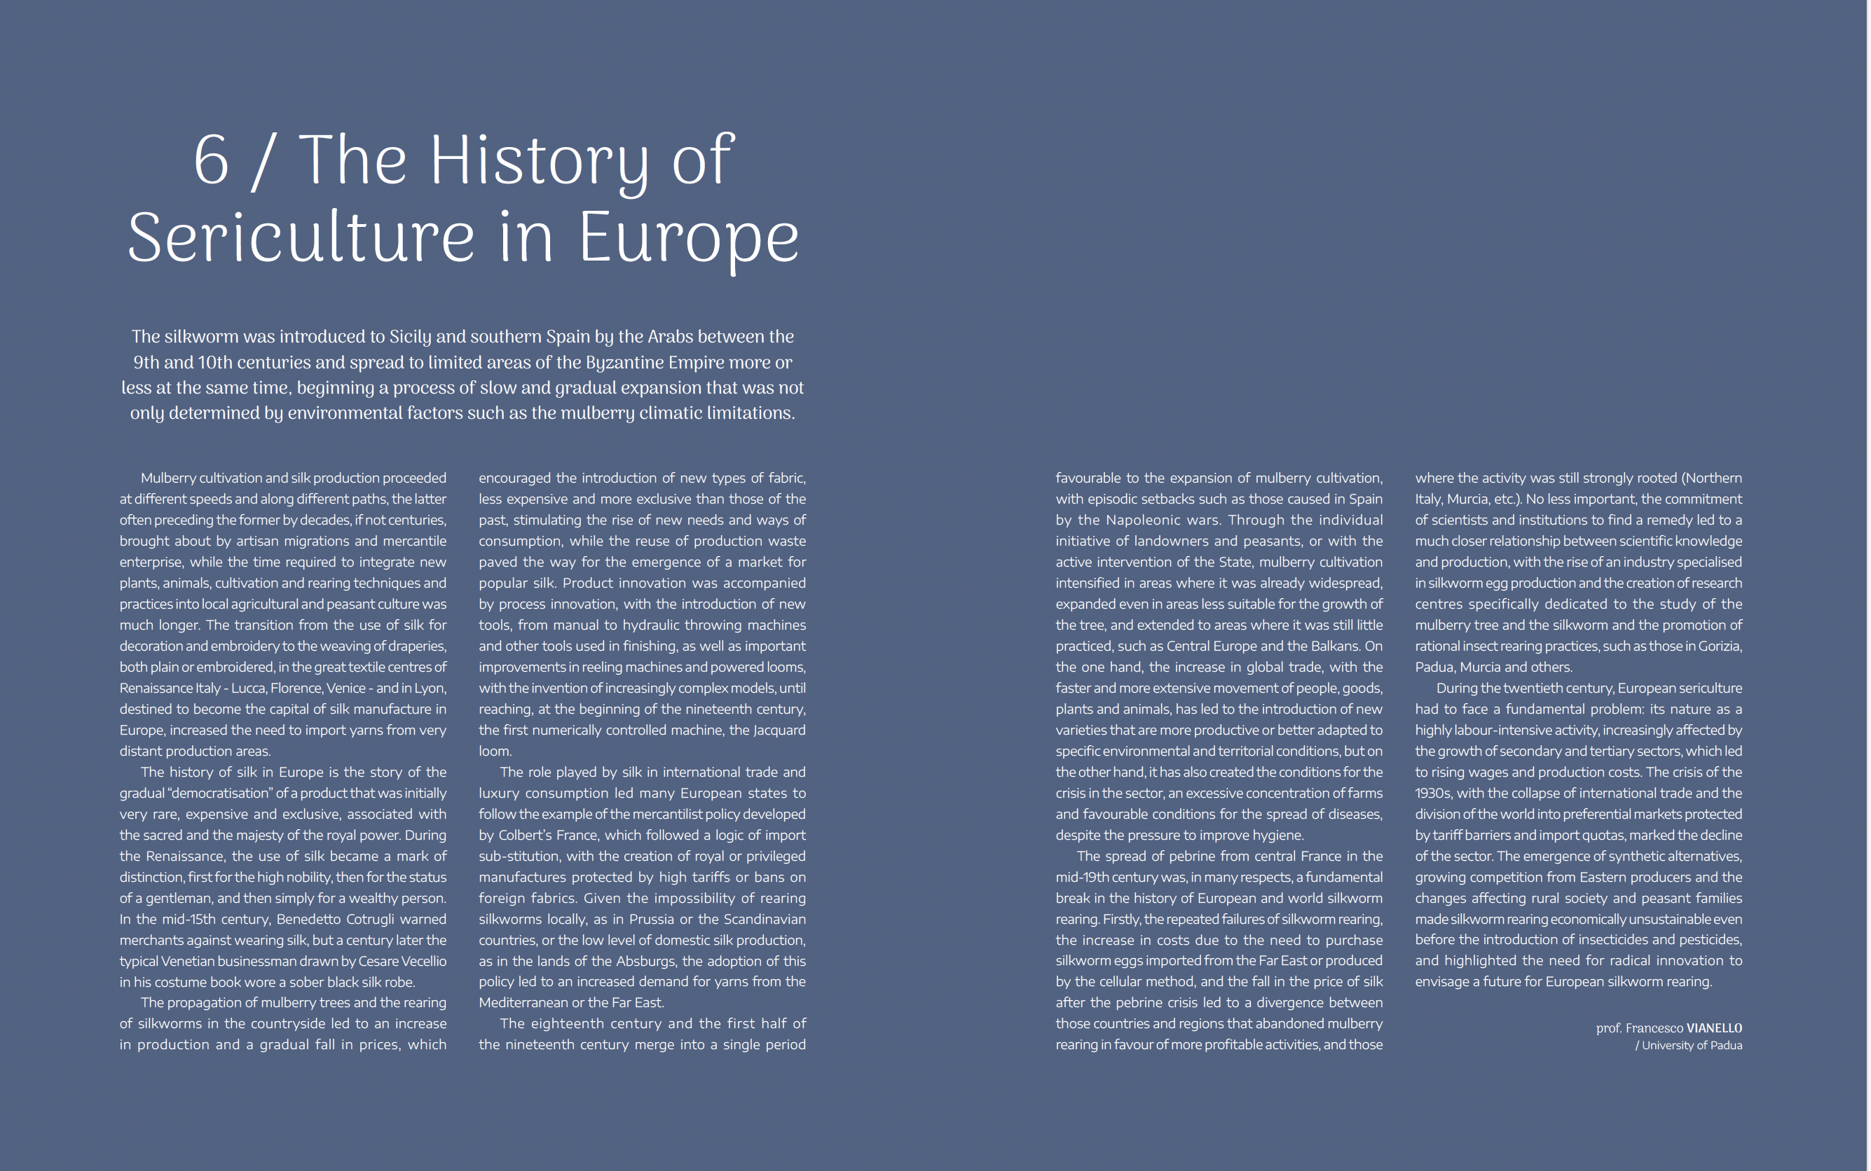

Slide 11
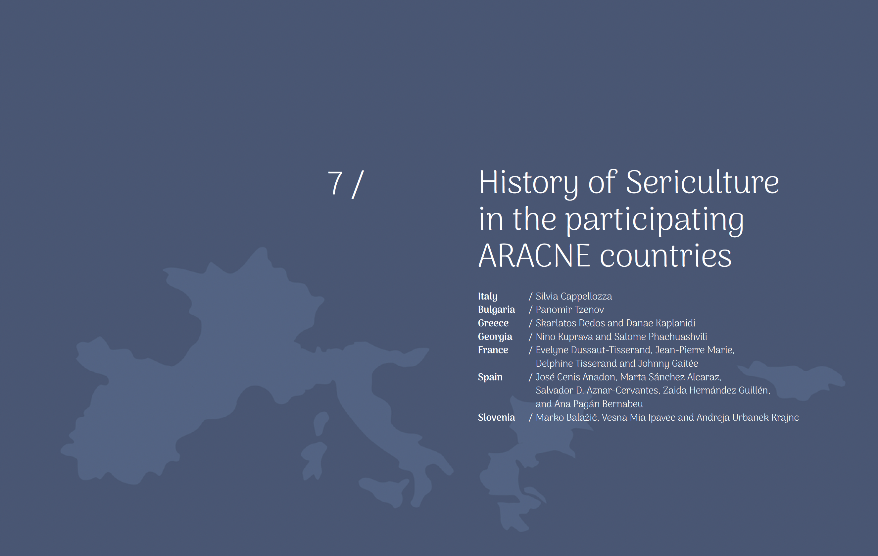

Slide 12
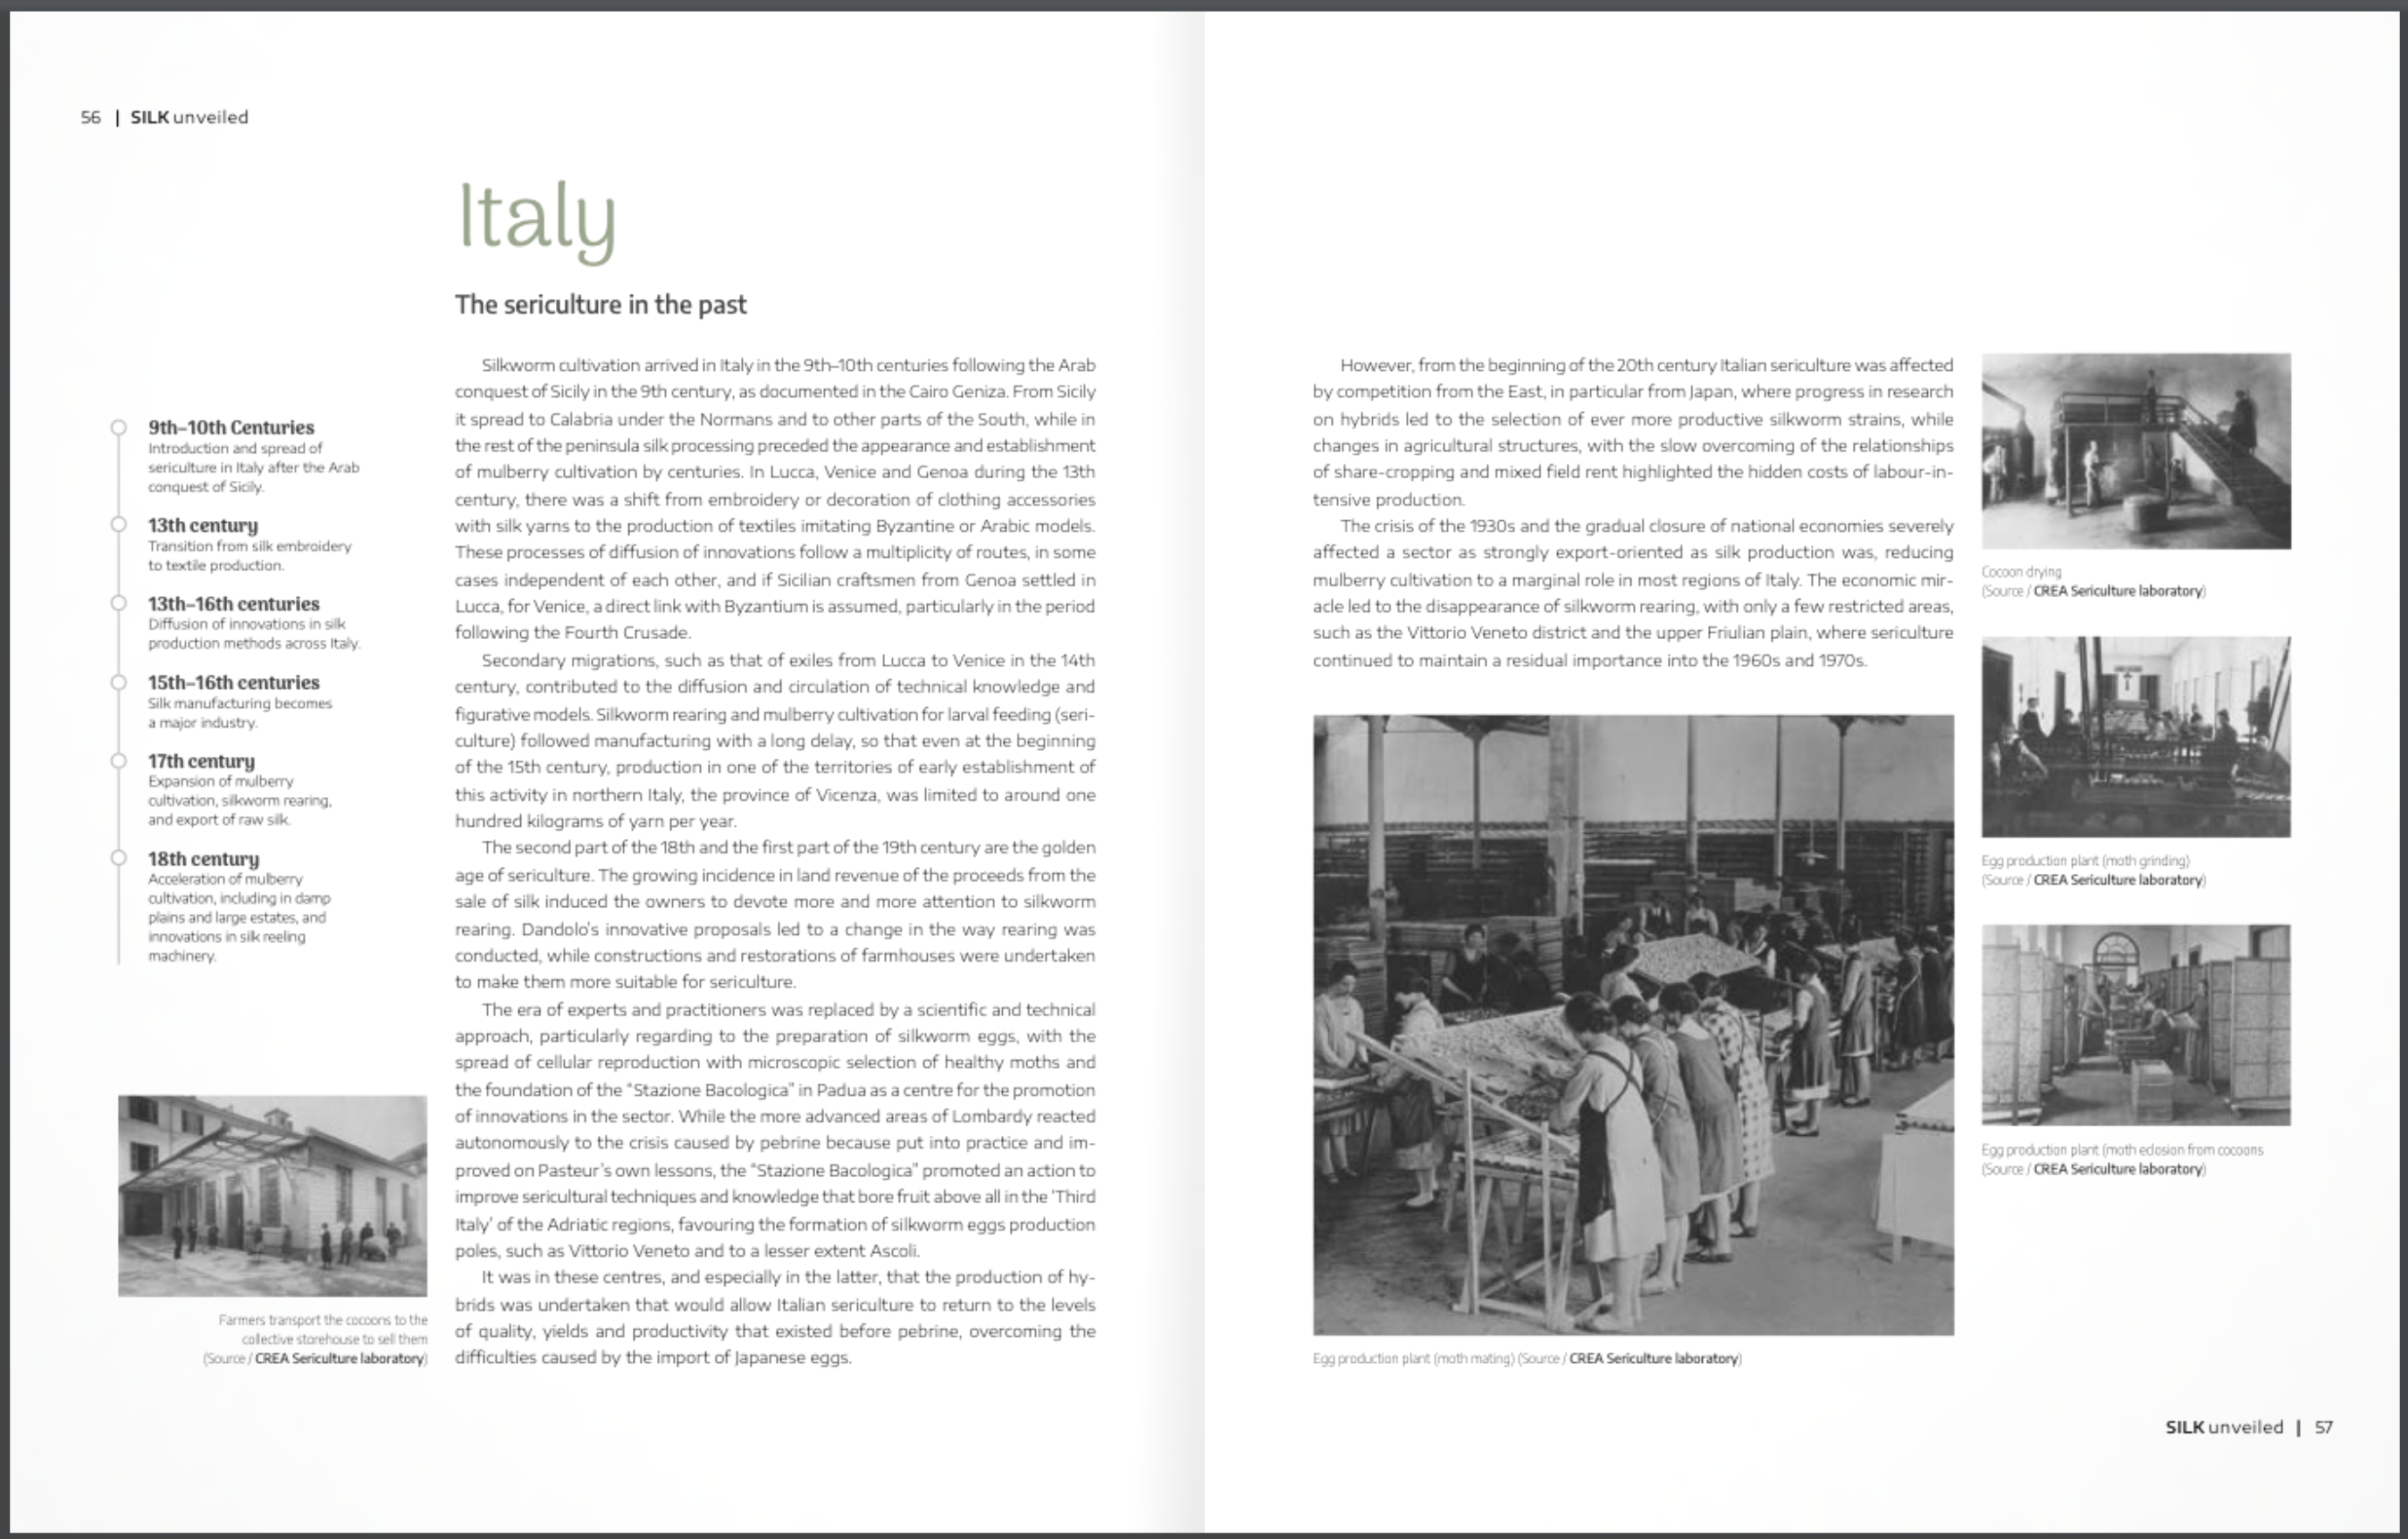

Slide 13
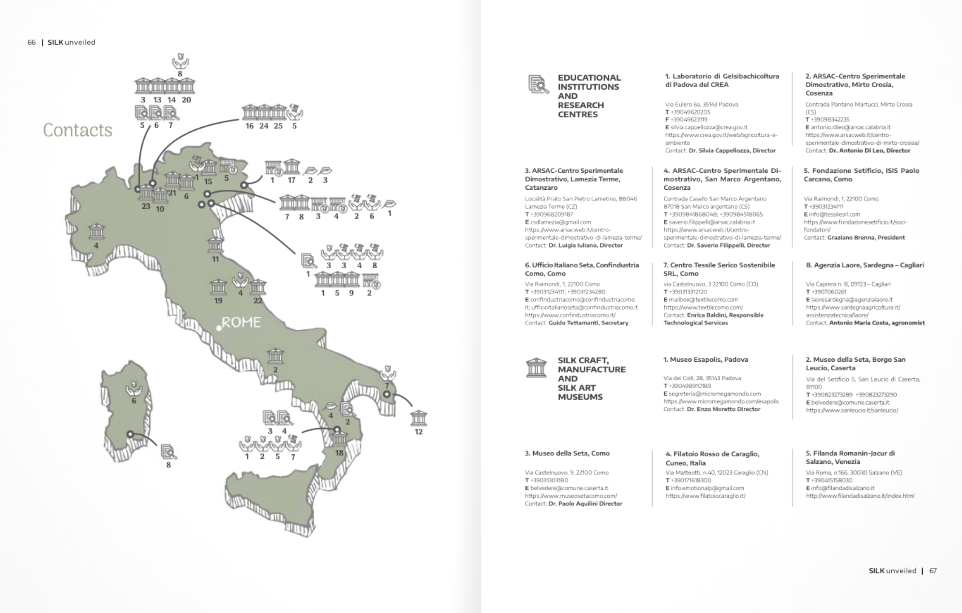

Slide 14
M35 (D1.8, Silk narrative catalogue v2.0)

Slide 15
ITALY
Consiglio per la ricerca in agricoltura e l’analisi dell’economia agraria (CREA)
Current Scenario of Silkworm Rearing.
Atelier Treesure
Fondazione Setificio
Museo ebraico
BULGARIA
Nauchen Tsentar po Bubarstvo Vratsa, Bulgaria (SCS)
Museum of the Textile Industry
National Agricultural Museum
Svila Silk Company - Svila JSC
Koynare sericulture farm

Slide 16
GREECE
Ancient greek scarves Soufli
Bourouliti Silk Handicrafts
Silk Museum of Soufli
Tsiakiris Silk House and the Art of Silk Museum
Silk Line Mouchtaridis Ath. S.A.
GEORGIA
The State Silk Museum
Georgian Textile Group (GTG)
Agricultural Scientific Research Center
The Sericulture Laboratory of the Agricultural University of Georgia
The Georgian Silk Association (GSA) and Lamara Bezhashvili

Slide 17
FRANCE
Maison Rouge - Musée des Vallées Cévenoles
Musée vivant du Ver à Soie
Musées de Charlieu
Silk Museum of Taulignan
Soierie Vivante
SPAIN
Instituto Murciano de Investigación y Desarrollo Agrario y Medioambiental (IMIDA)
Colegio del Arte Mayor de la Seda
Las Hilanderas Museum – Workshop
Murcia Silk Station
Textile Museum and Documentation Centre

Slide 18
SLOVENIA
The University of Maribor
Heritage Science Lab Ljubljana
Ecclesiastical Silk Liturgical Heritage Institutions
The Regional Museum of Ptuj-Ormož and The Maribor Regional Museum
Slovenian Rearers and Silk Craftsmen

Slide 19
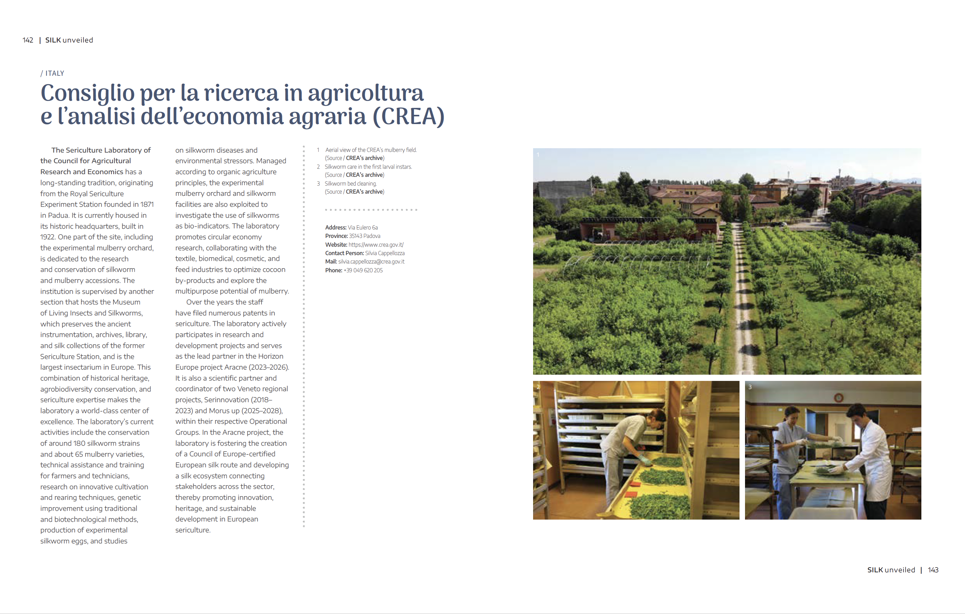

Slide 20
https://medijske.um.si/aracne/flipbook/catalog-silk-unveiled/

Slide 21
Thank You!

